Slide 1
Department of Human Development
Activities Conducted in 2025-26

Slide 2
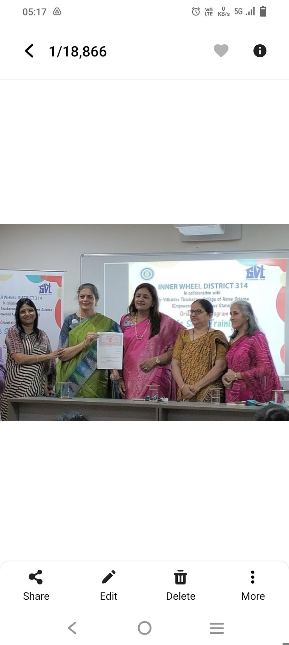
MOU Signed by the Department of Human Development
MOU for Counsultancy and Training by Department of Human Development, Sir Vithaldas Thackersey College of Home Science (Empowered Autonomous Status) in collaboration with Innerwheel District 314 on “Surakshit Jeevan-Self awareness and personal development” June to August 2025

Slide 3
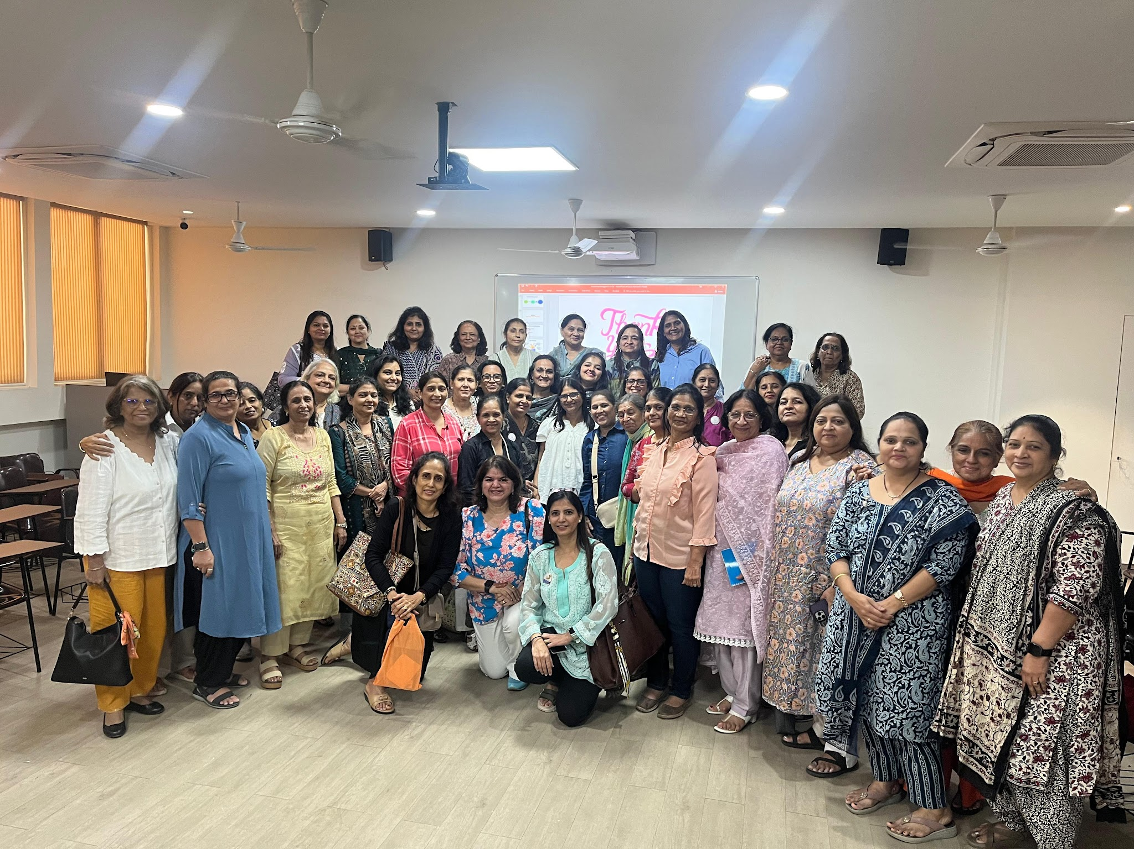
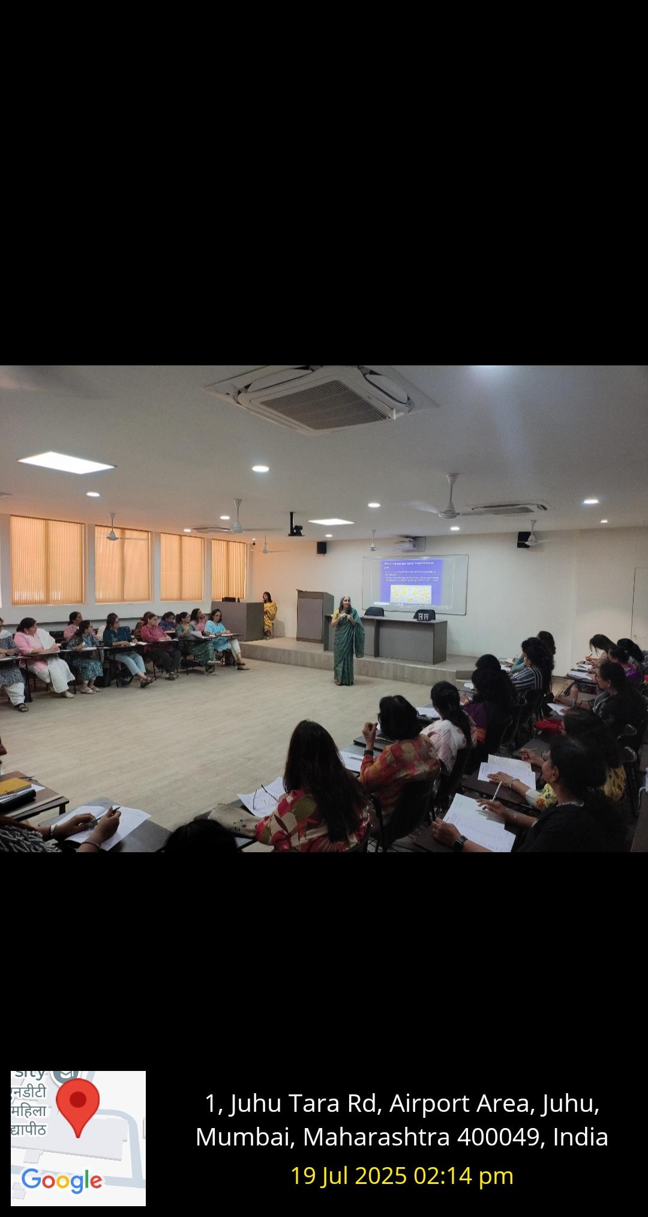
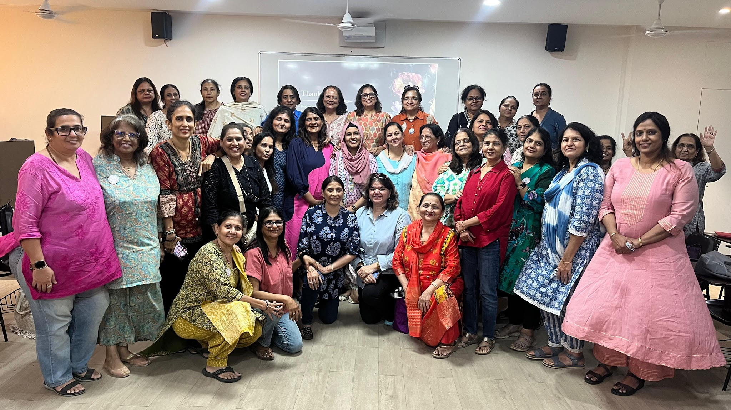
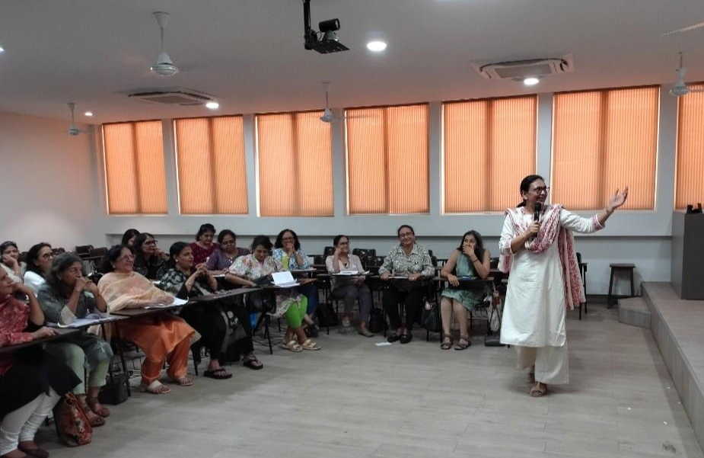
Surakshit Jeevan Training Sessions- July 2025-August 2025
Ms. Archana Jain,
Dr. Bhamini Mehta,
Ms. Anushri Soni &
Ms. Samreen Khan conducted life skills training workshops for women in the community under the program Surakshit Jeevan in collaboration with Innerwheel Club of Mumbai Midwest.

Slide 4
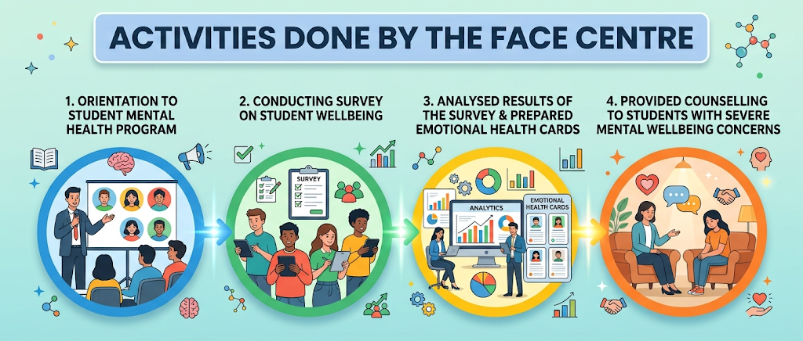
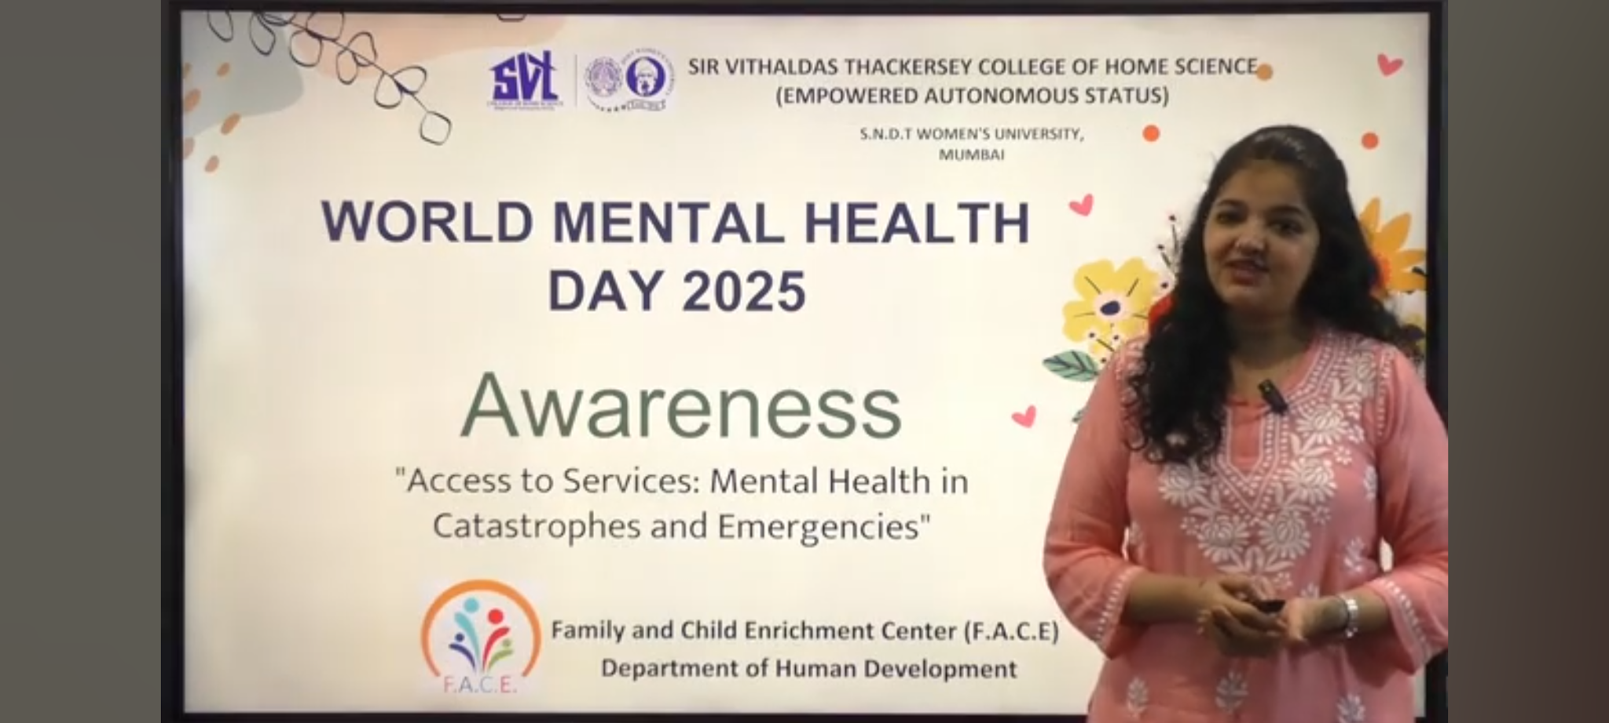
Mental Health Initiatives Taken by FACE Centre
Planning & Conducting Student Mental Health Program
Message on World Mental Health Day 2025 on ‘Awareness About Mental Health Services during Emergencies’

Slide 5
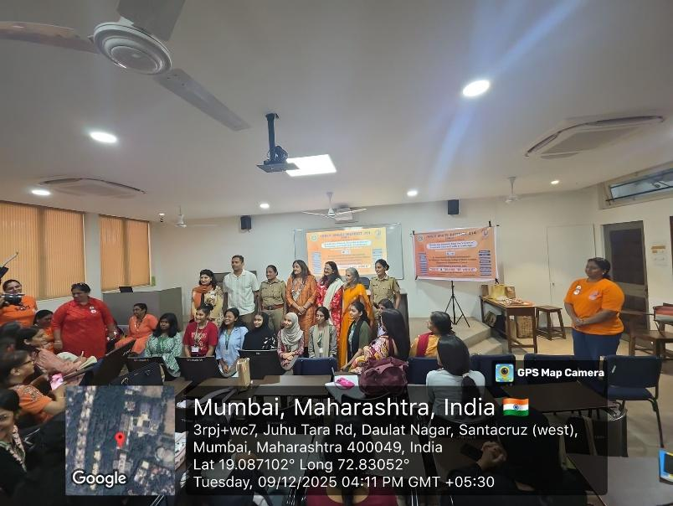
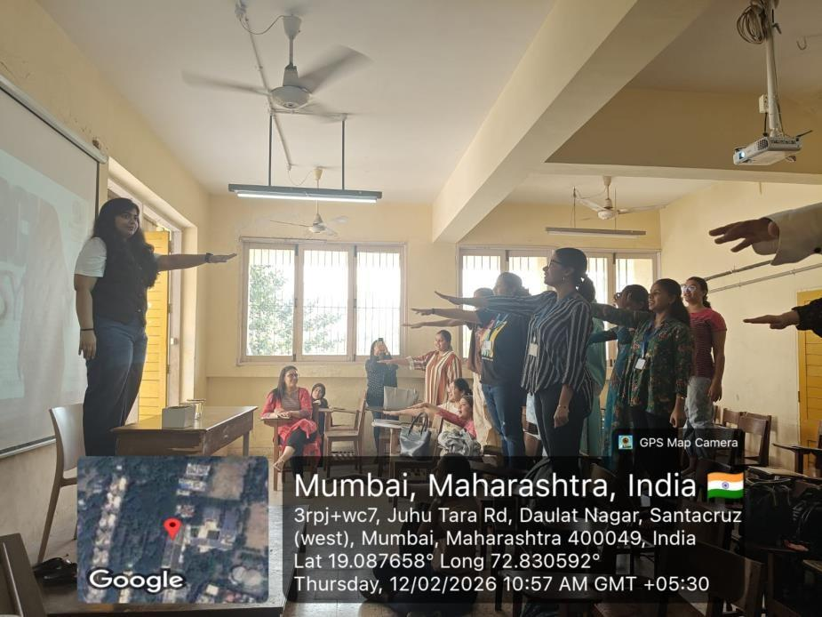
Elimination of Violence Against Women on 9th December 2025
Research the Easy Way-Steps in Conducting a Research on 12th February 2026
Student Enrichment Activities- Guest Lectures & Talks

Slide 6
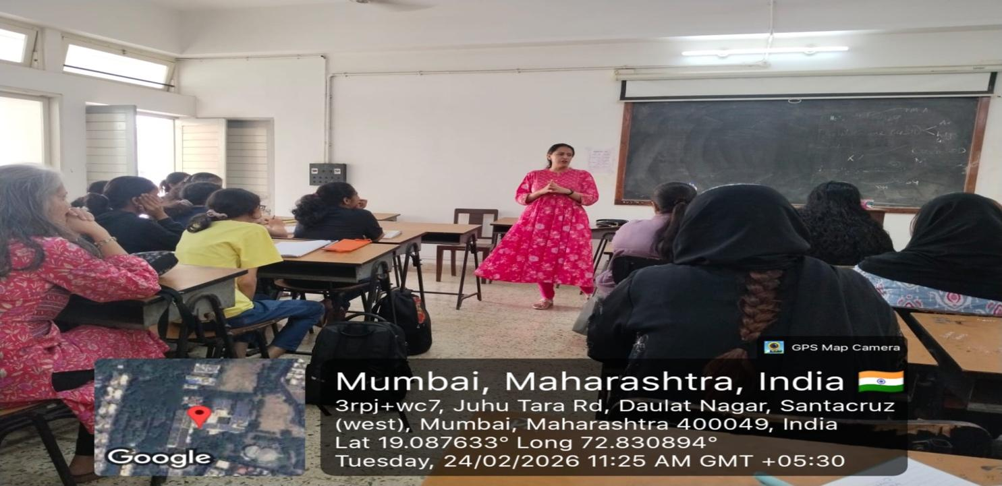
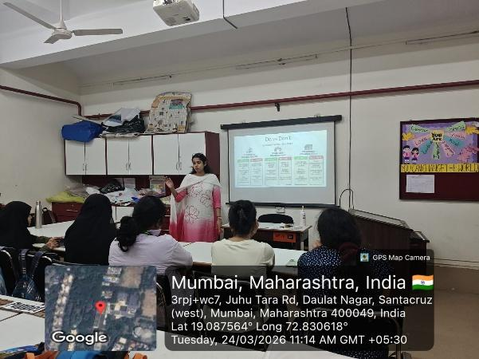
Journey of Becoming a Counsellor on 24th February 2026
Qualities of a Shadow Teacher on 24th March 2026
Student Enrichment Activities- Guest Lectures & Talks

Slide 7
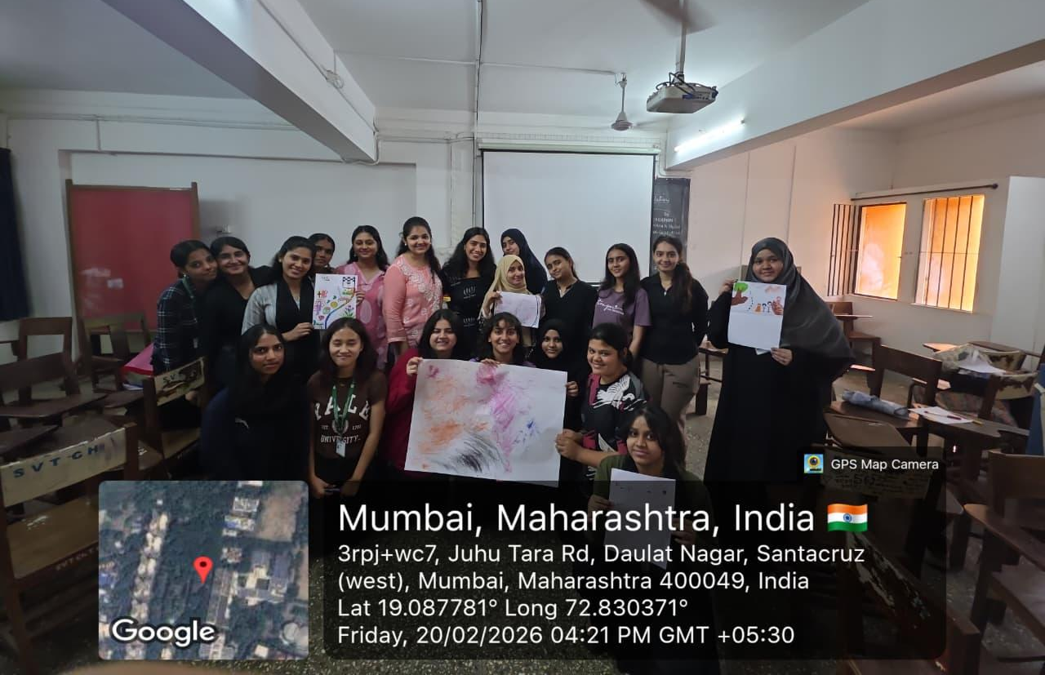
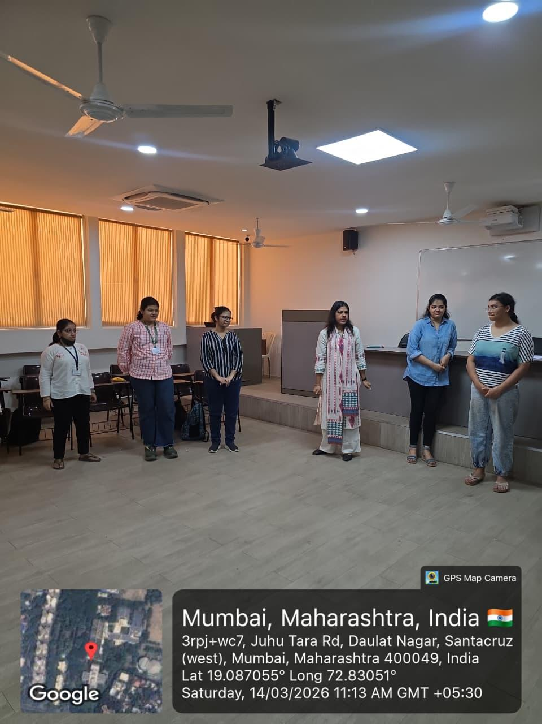
Workshops for Students
Art Therapy Workshop on 20th February 2026
Social & Emotional Learning Practices for Wellbeing on 14th March 2026

Slide 8
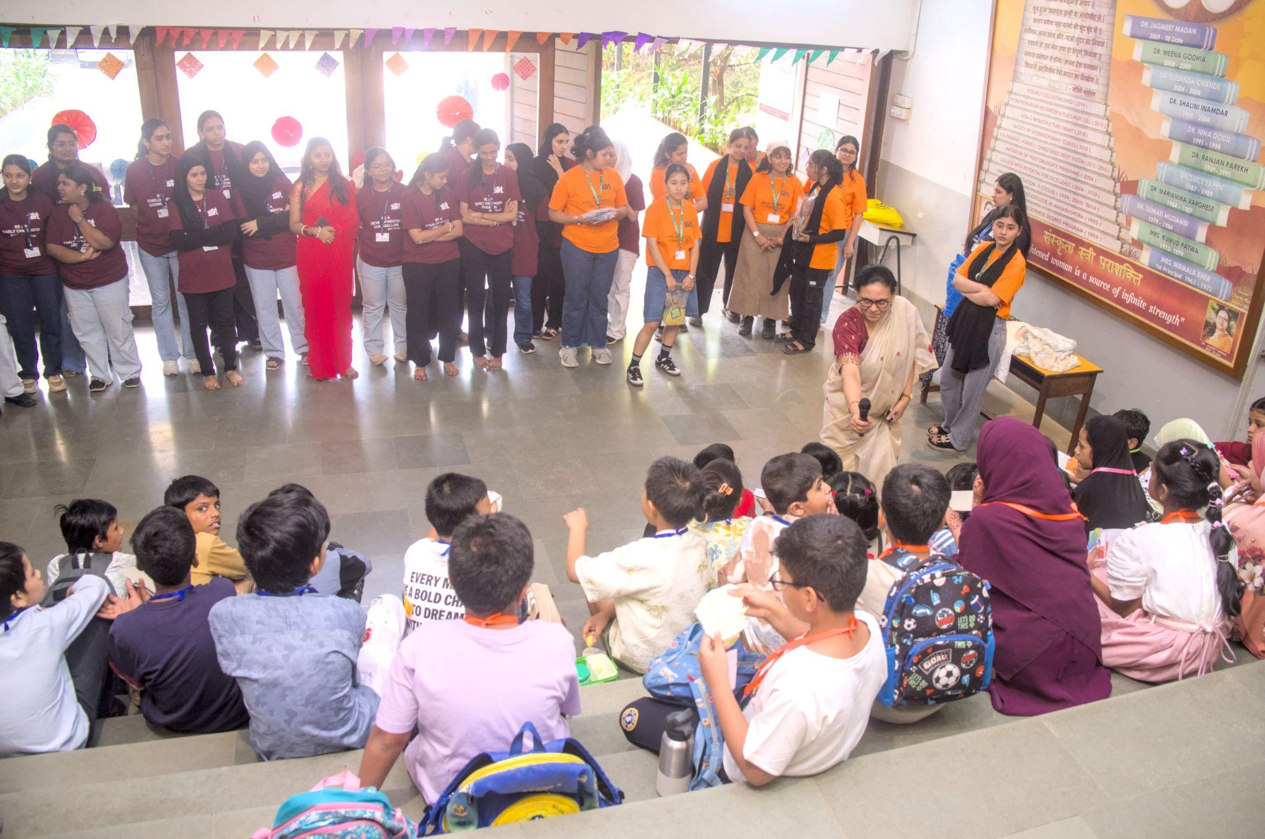
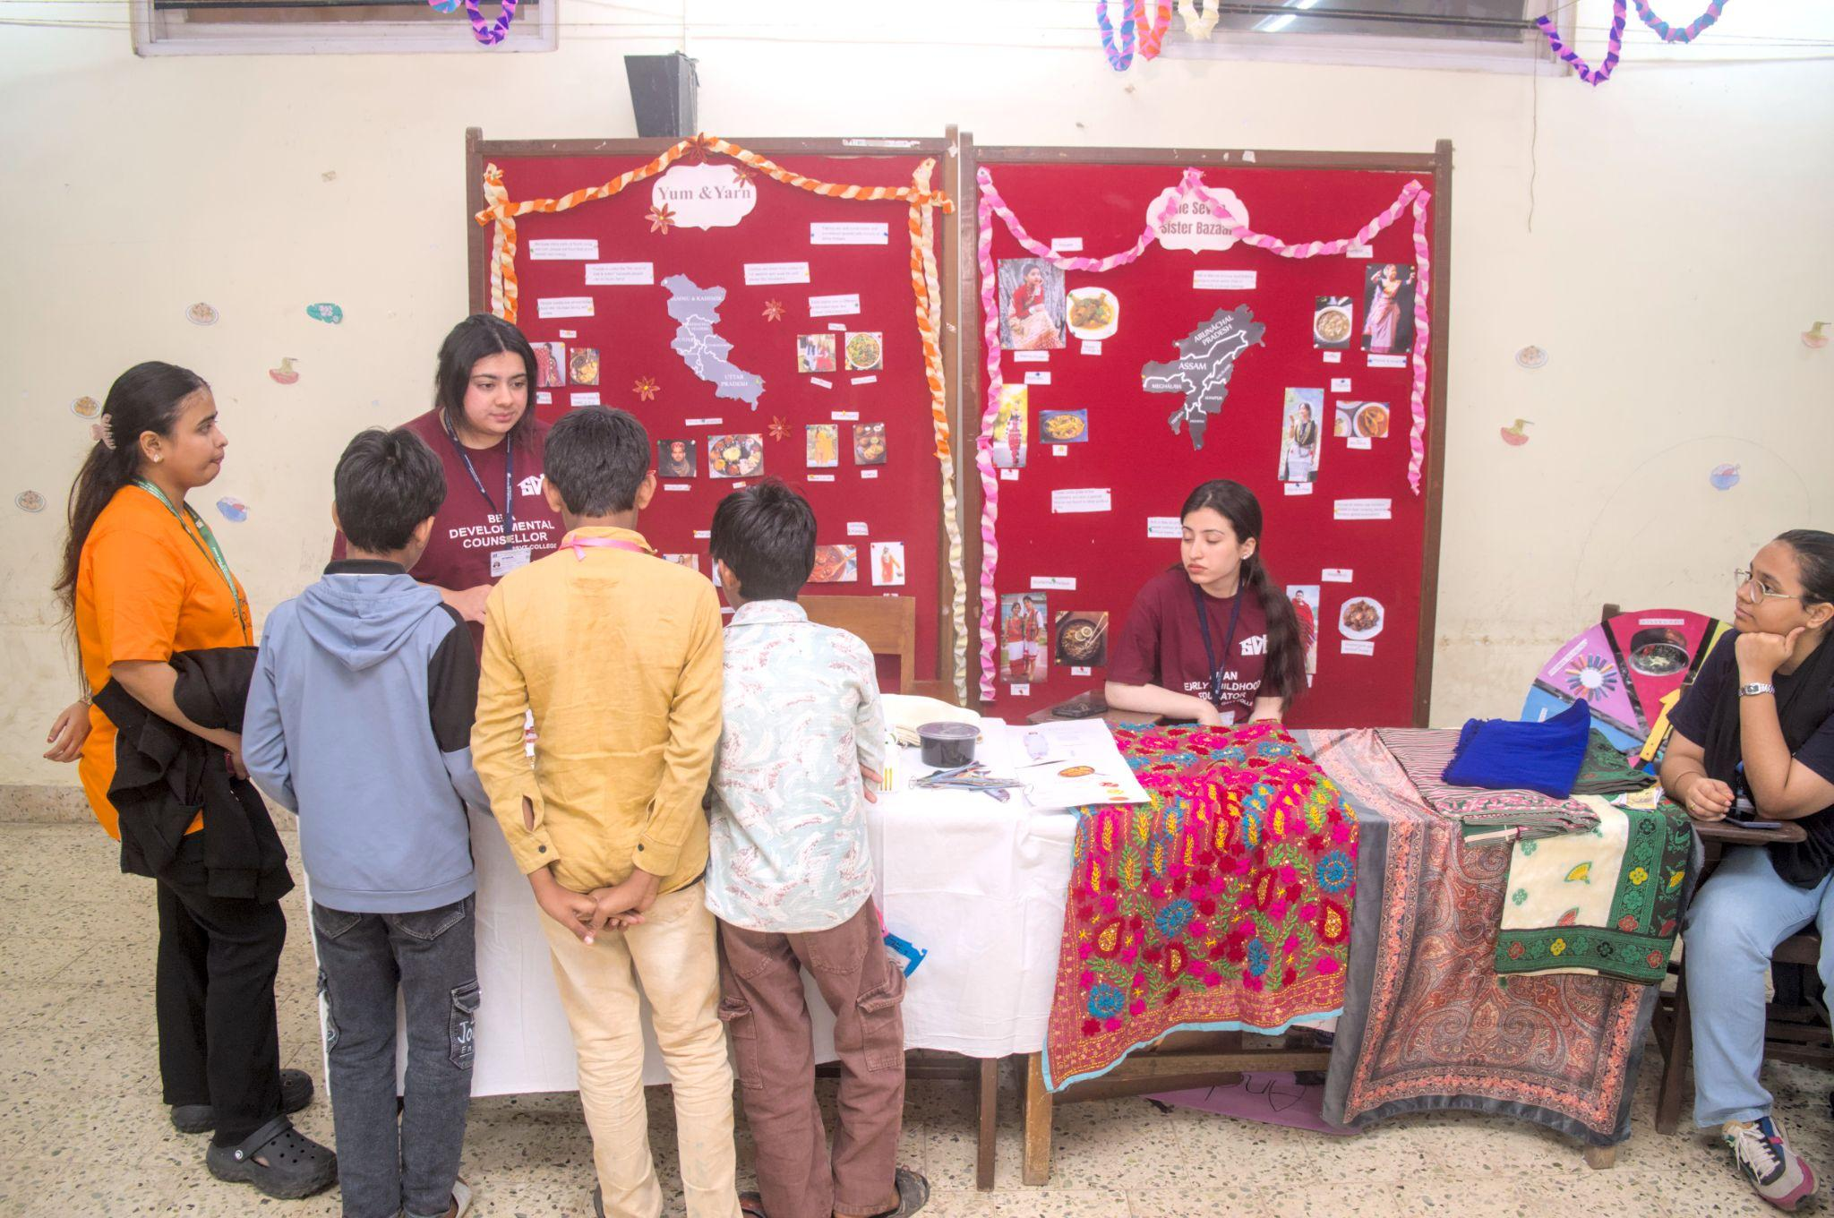
Khel Utsav- Bharat: The Cultural Mosaic, on 21st December 2025
The third year students planned and executed interactive educational games on the theme of Indian Culture for children between the ages of 6 years to 12 years.

Slide 9
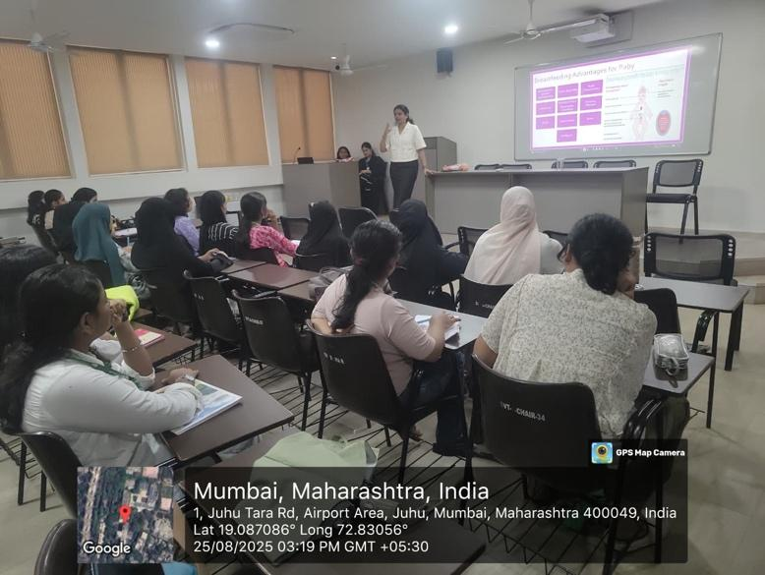
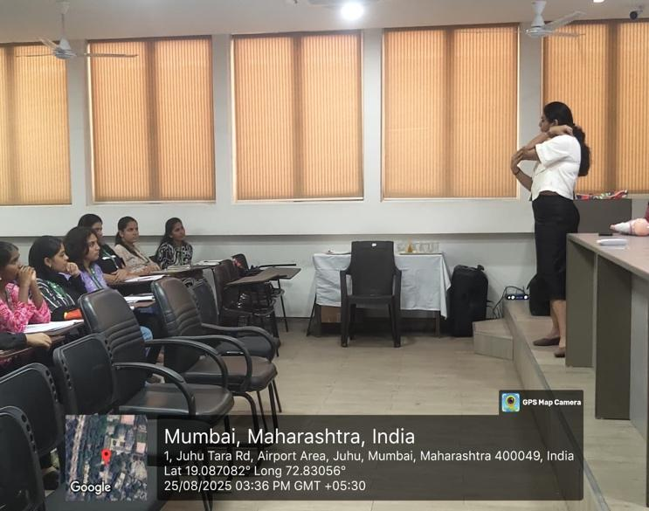
Celebration of Significant Days
Seminar on Importance of Breastfeeding on 25th August 2025

Slide 10
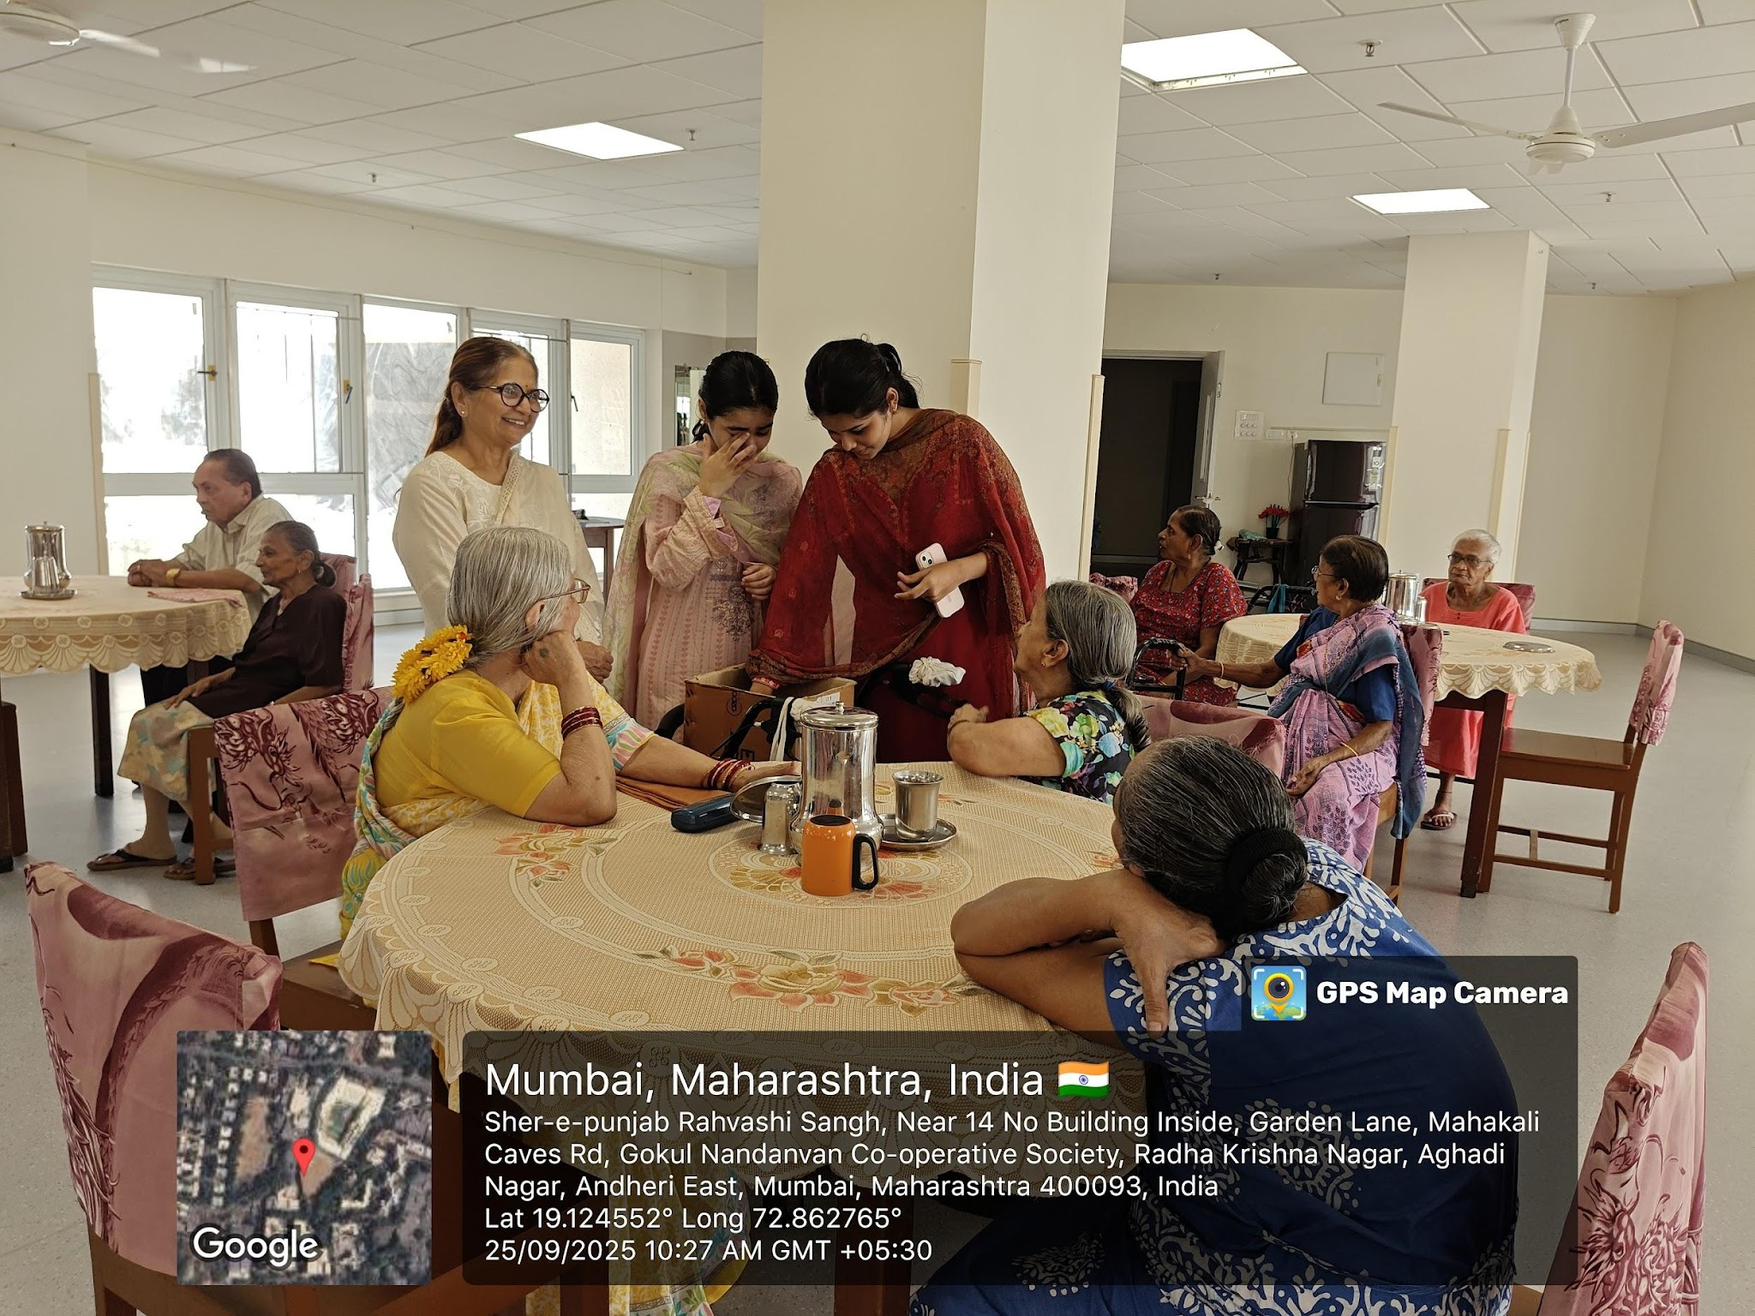
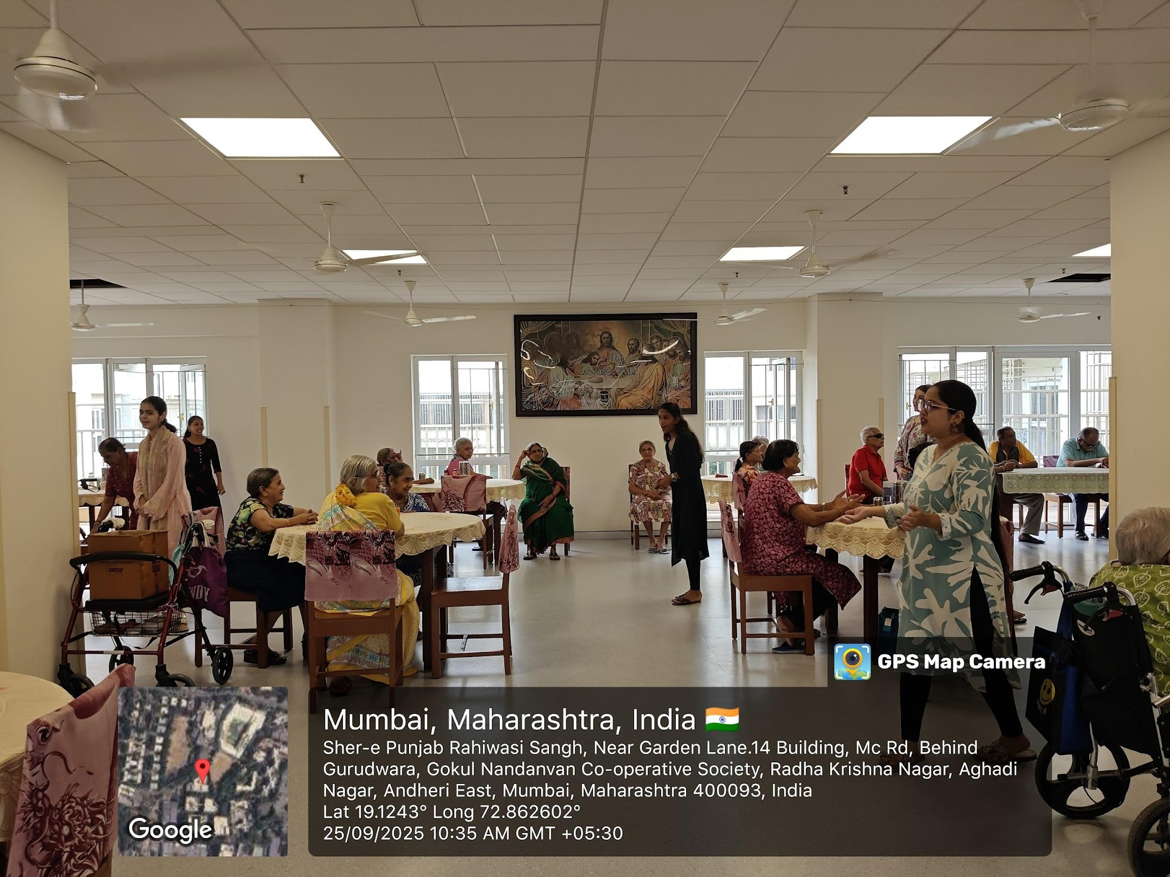
Celebration of Significant Days
Senior Citizens Day on 25th September 2025

Slide 11
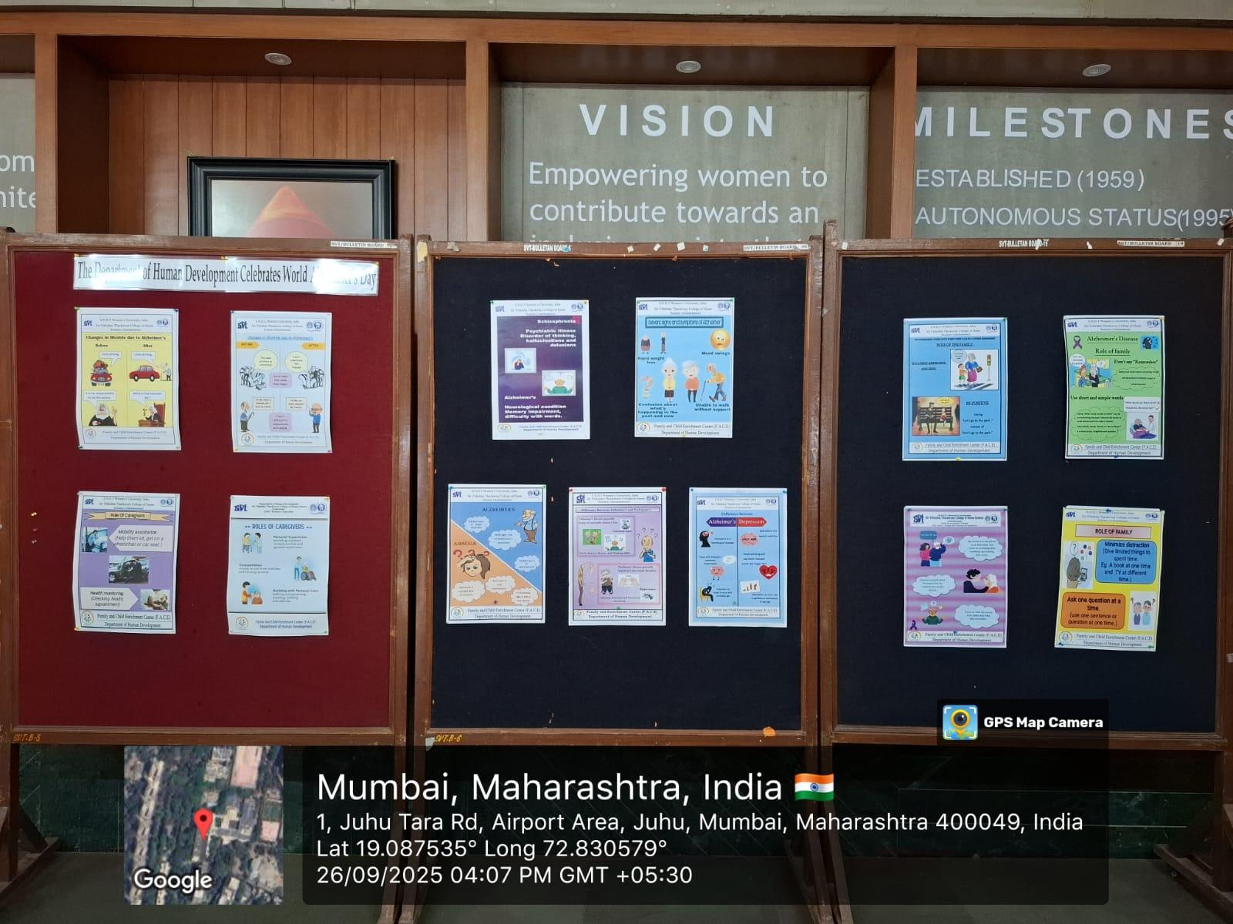
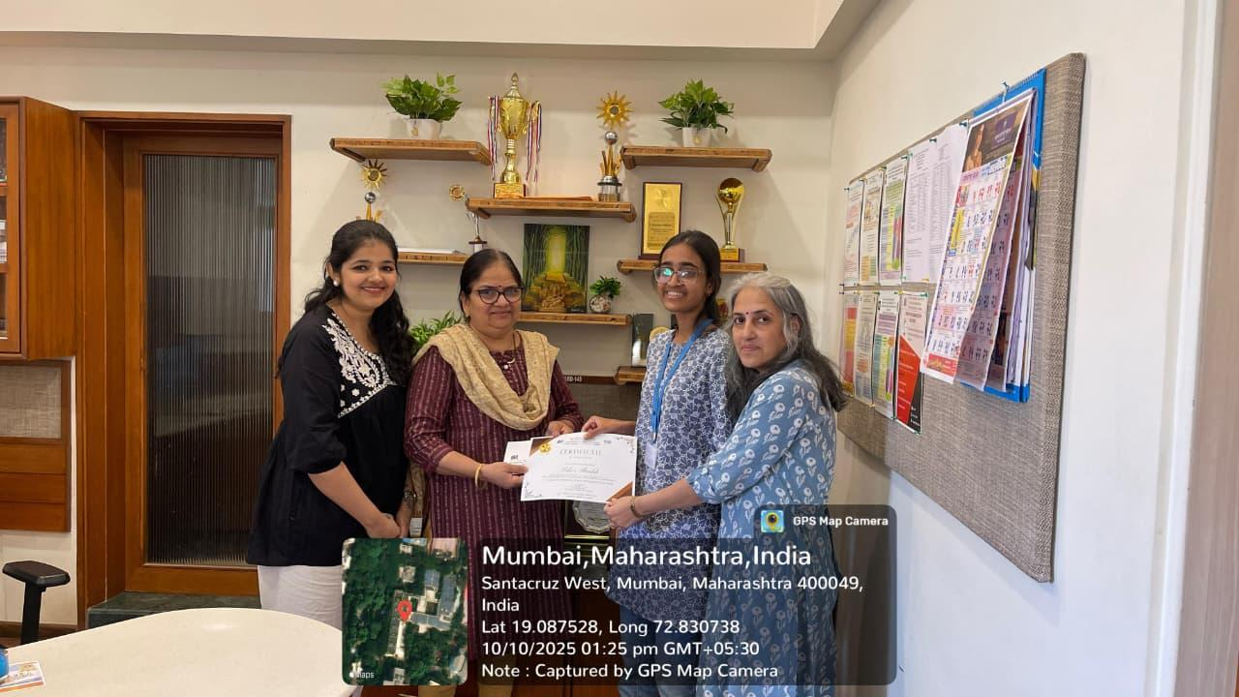
Celebration of Significant Days
Awareness on Alzheimer’s Disease through Display of Posters & Quiz during September 2025

Slide 12
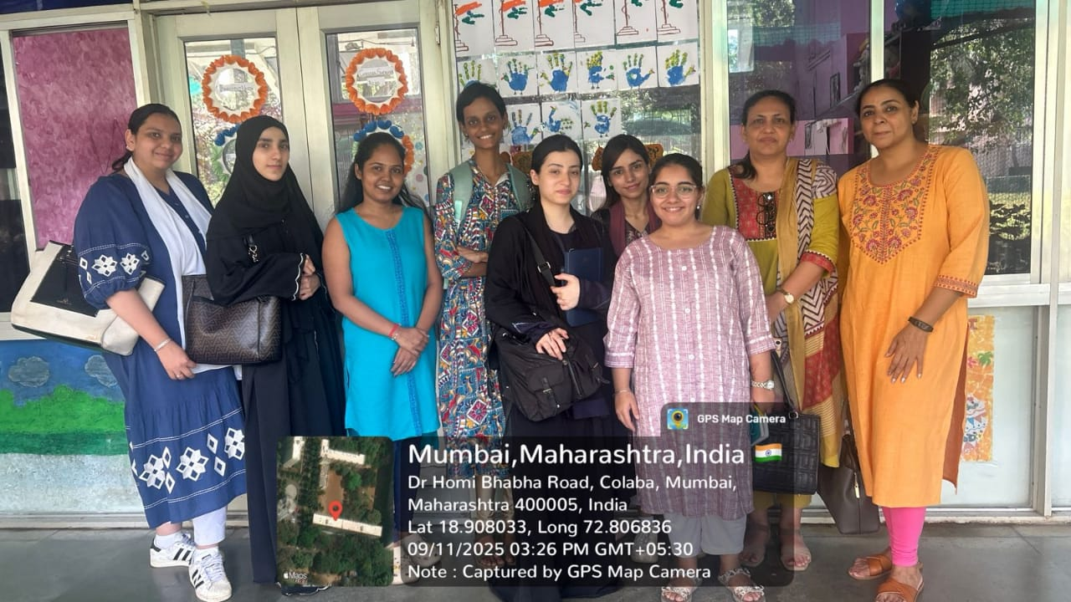
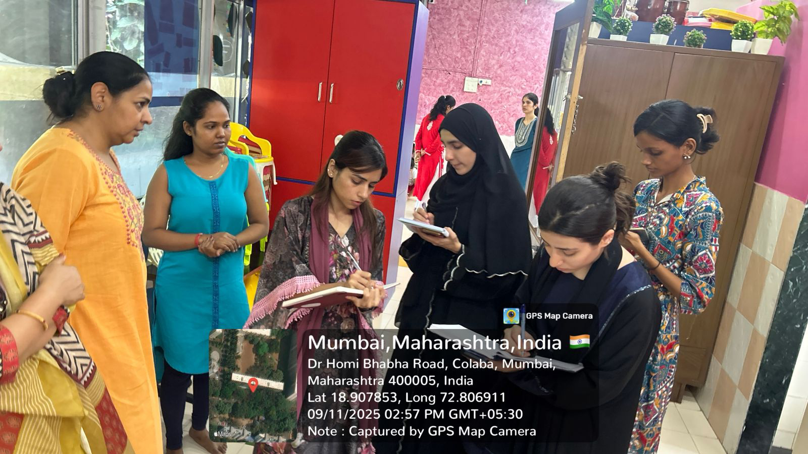
Educational Visits
Tata Institute for Fundamental Research (TIFR) Child Care Centre, on 11th September 2026

Slide 13
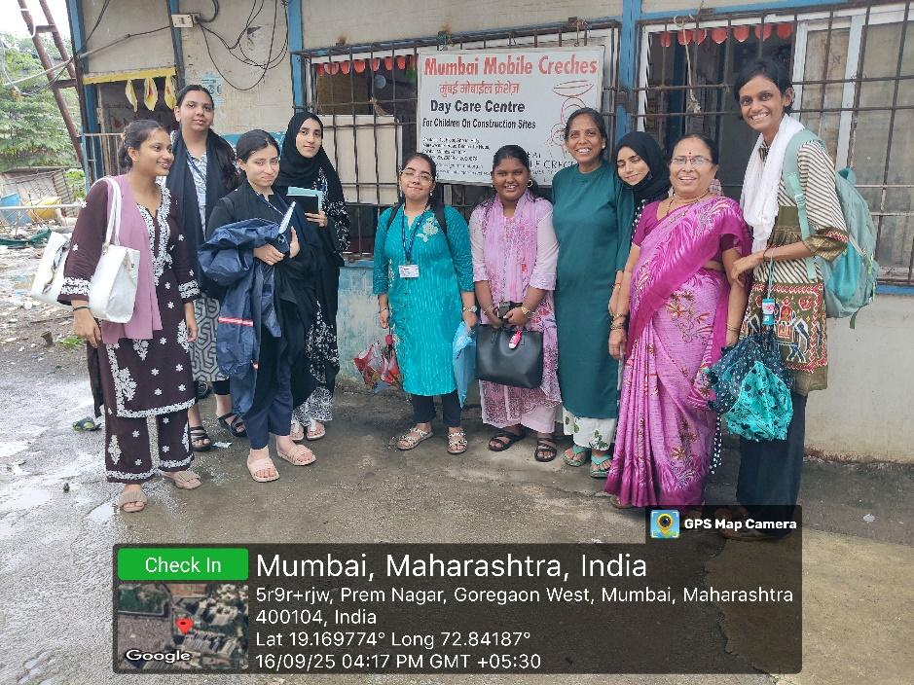
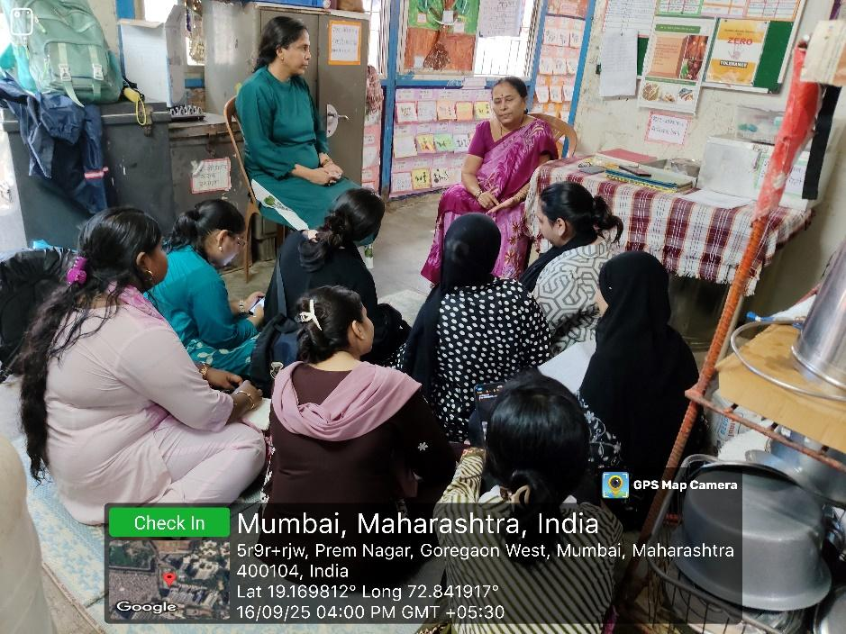
Educational Visits
Mumbai Mobile Creche, on 16th September 2025

Slide 14
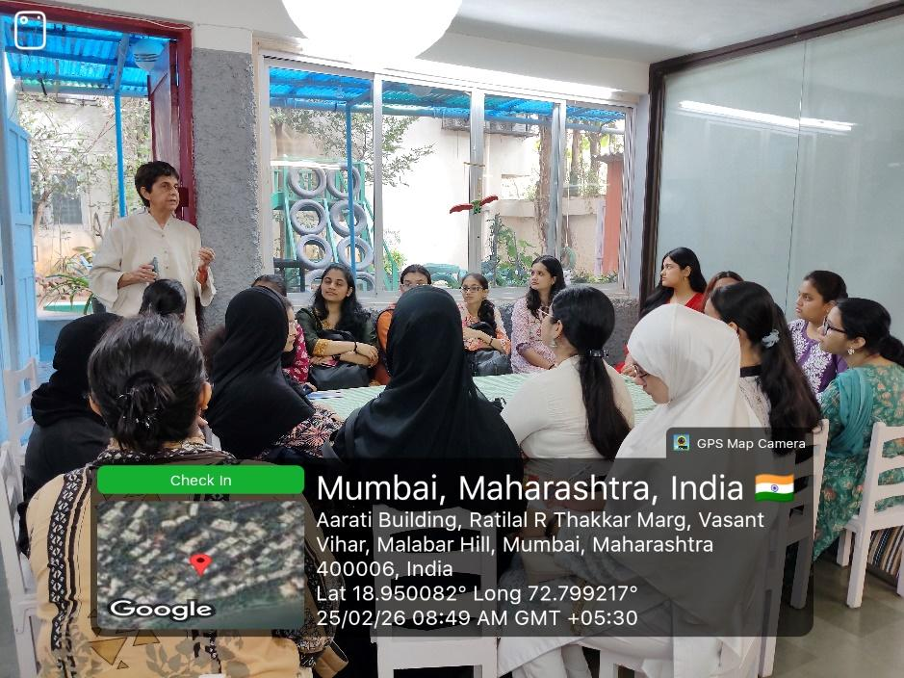
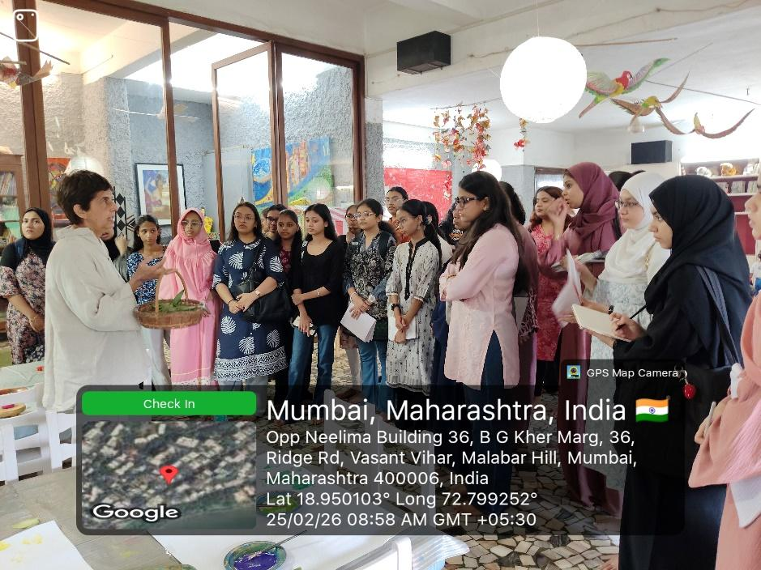
Educational Visits
Sunflower Nursery School, on 25th February 2026

Slide 15
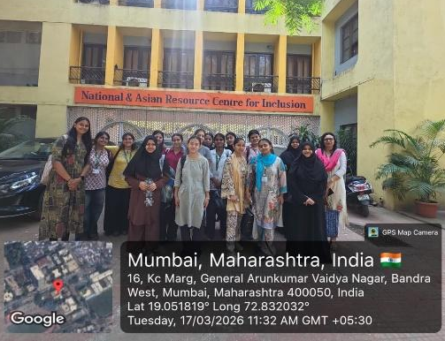
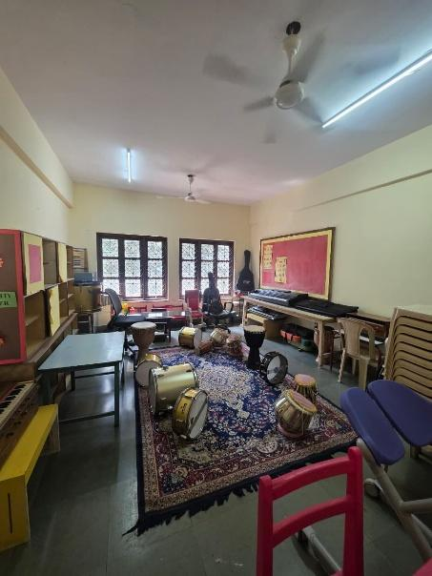
Educational Visits
Special School - ADAPT, on 17th March 2026

Slide 16
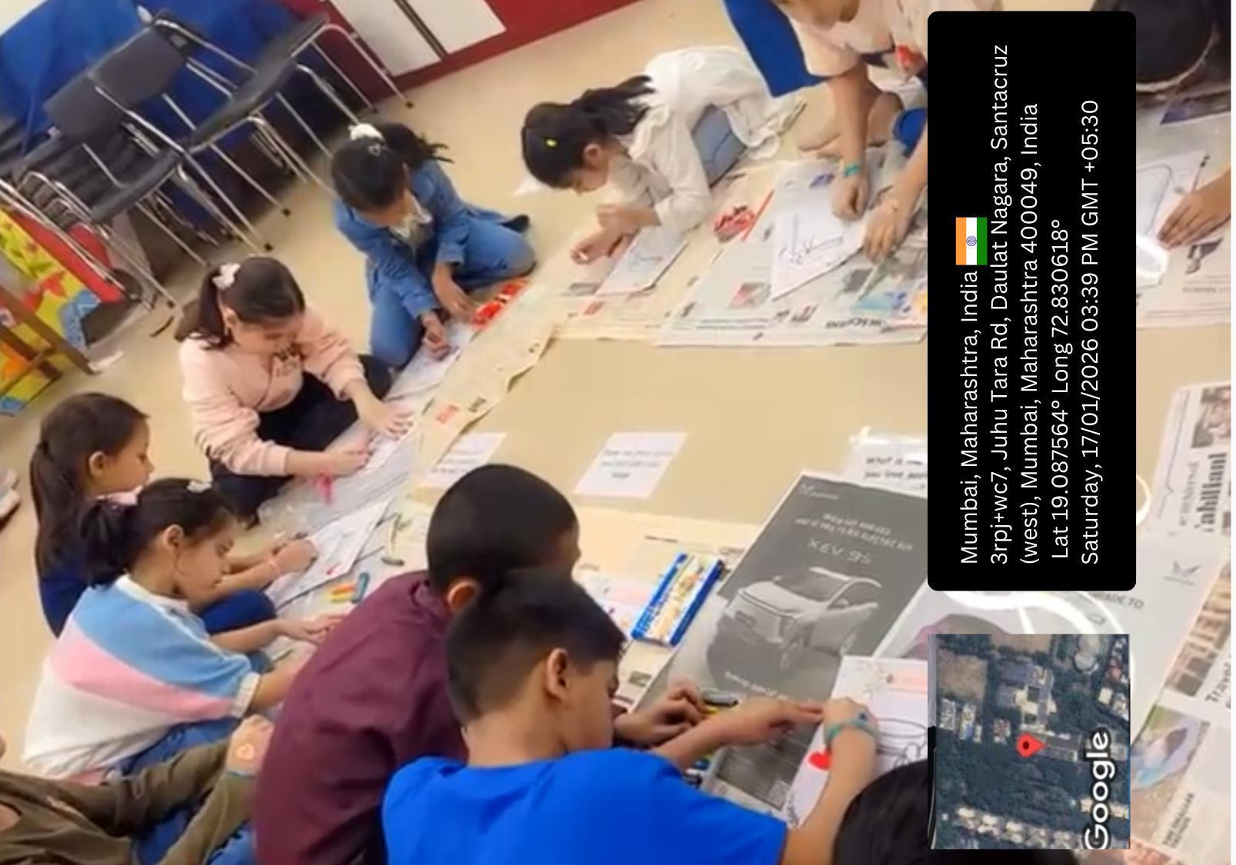
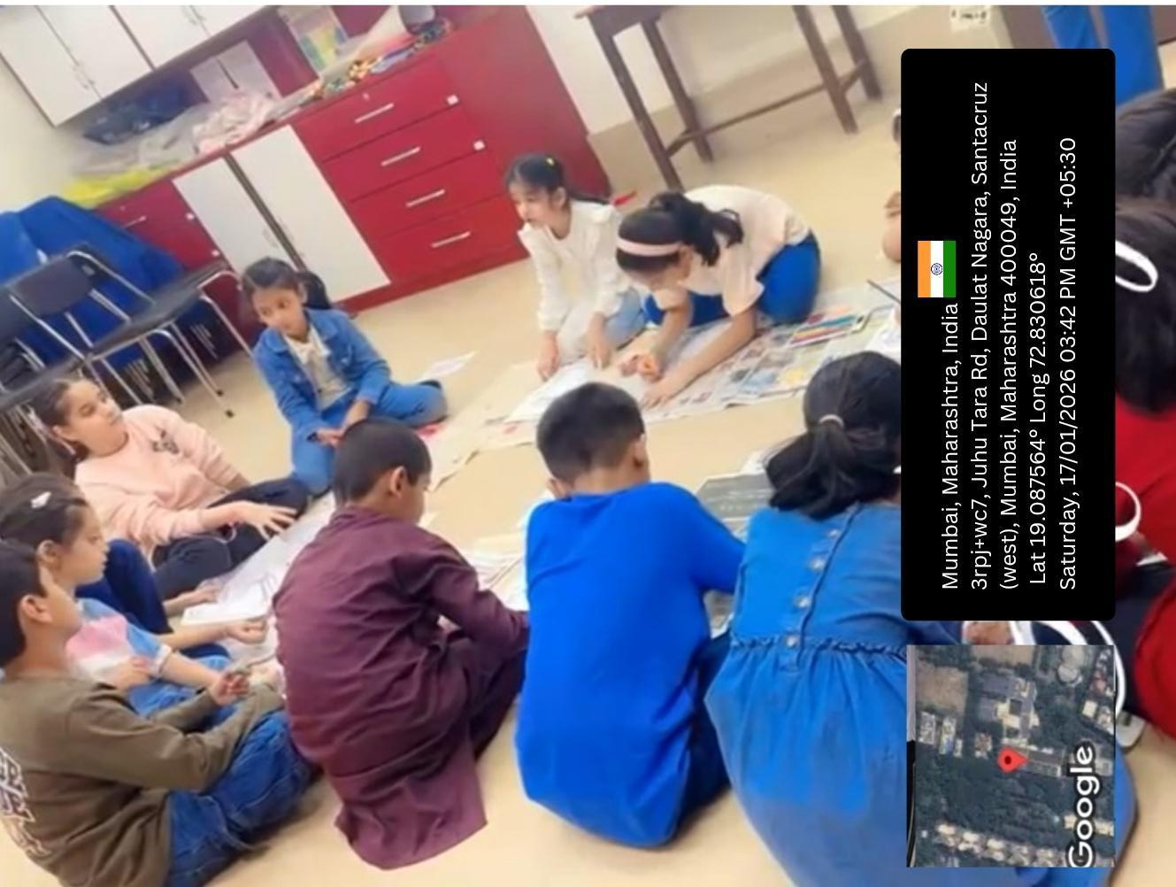
Extension Activities
Workshops for Children & Adolescents in the Community
Workshop on Importance of Gratitude on 17th January 2026

Slide 17
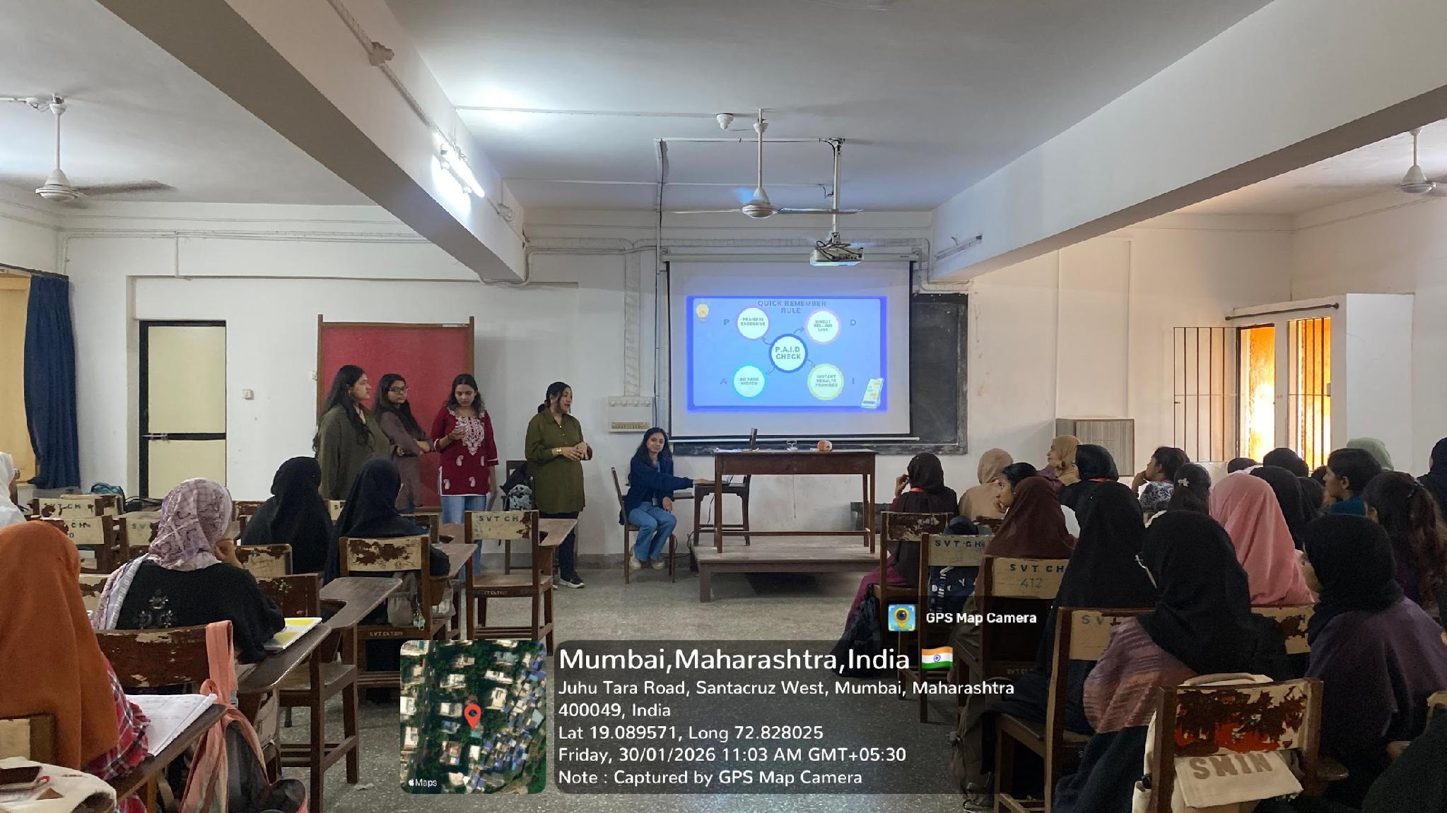
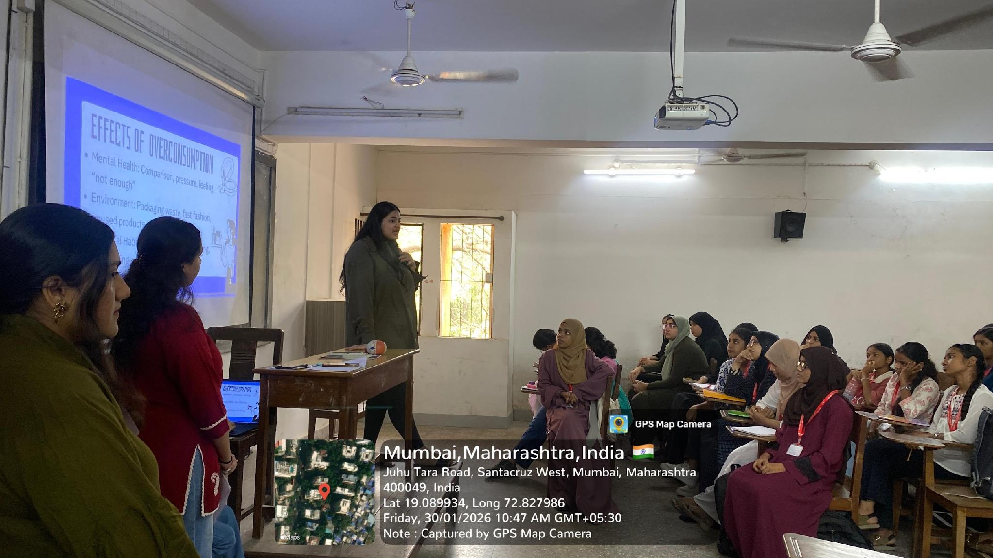
Extension Activities
Workshops for Children & Adolescents in the Community
Workshop on Healthy Usage of Social Media on 31st January 2026

Slide 18
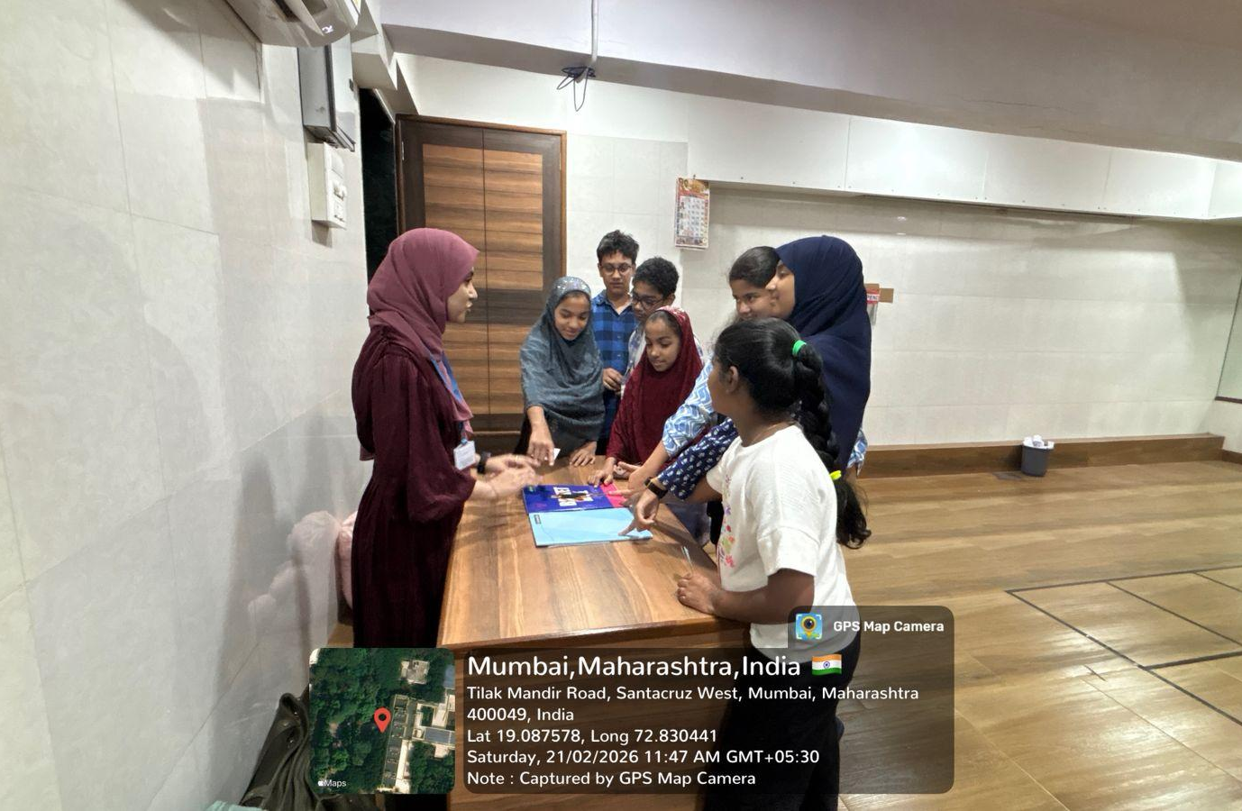
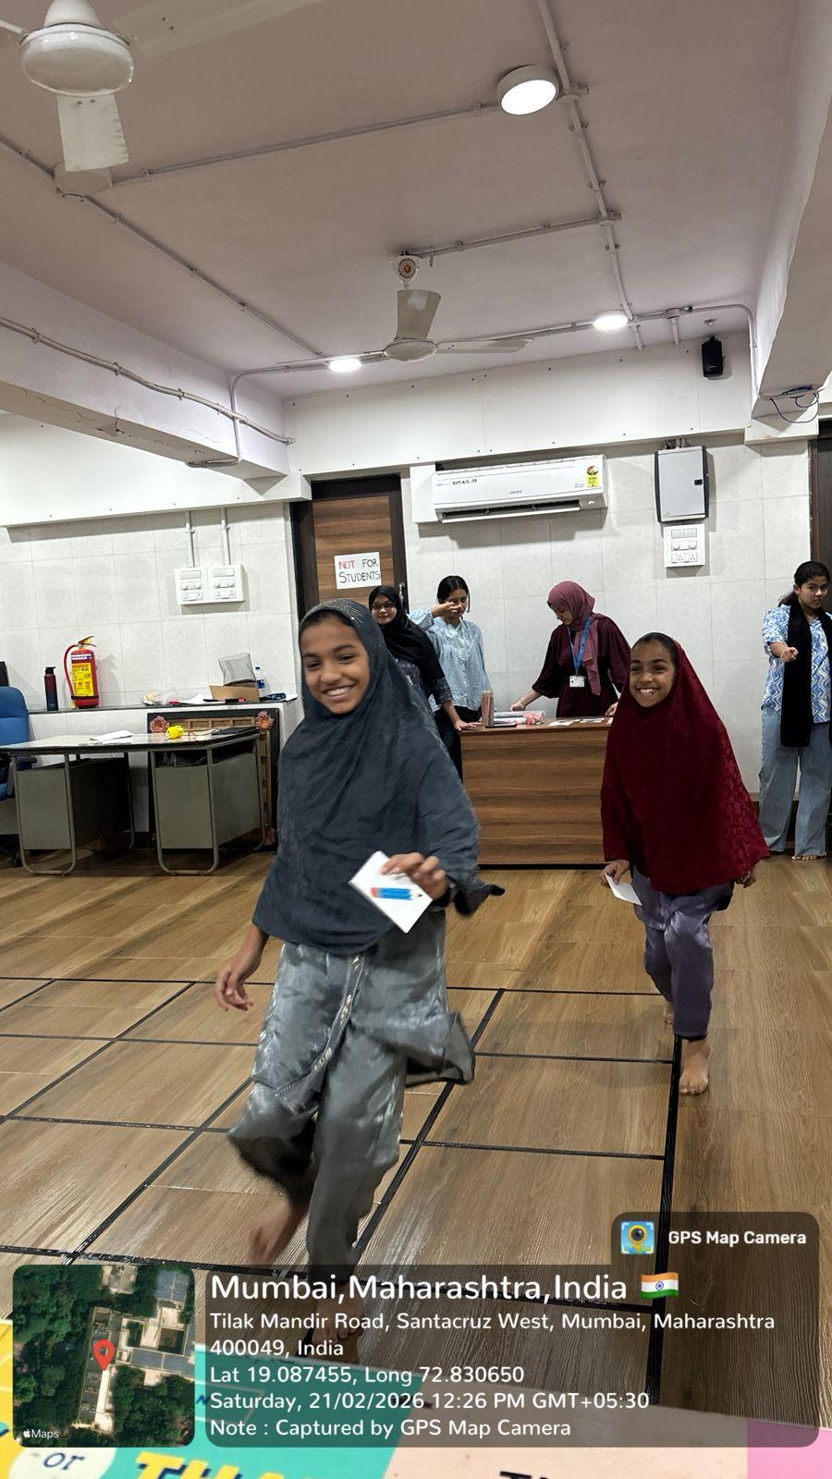
Extension Activities
Workshops for Children & Adolescents in the Community
Workshop on Money Basics for Children on 21st February 2026

