Slide 1
DEPARTMENT OF HUMAN DEVELOPMENT
1st Jan 2023 to 30th April 2024

Slide 2
“Planning Learning Corners Through The NEP Lens”: A workshop for school teachers on February 11, 2023 in collaboration with AECED

Slide 3
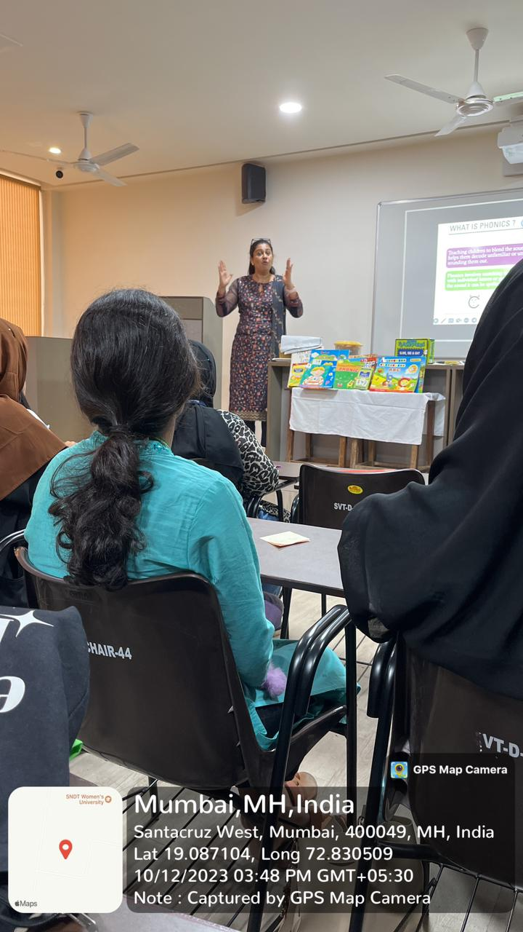
Workshop on Phonics Ms. Swati Bhatt October 12, 2023

Slide 4
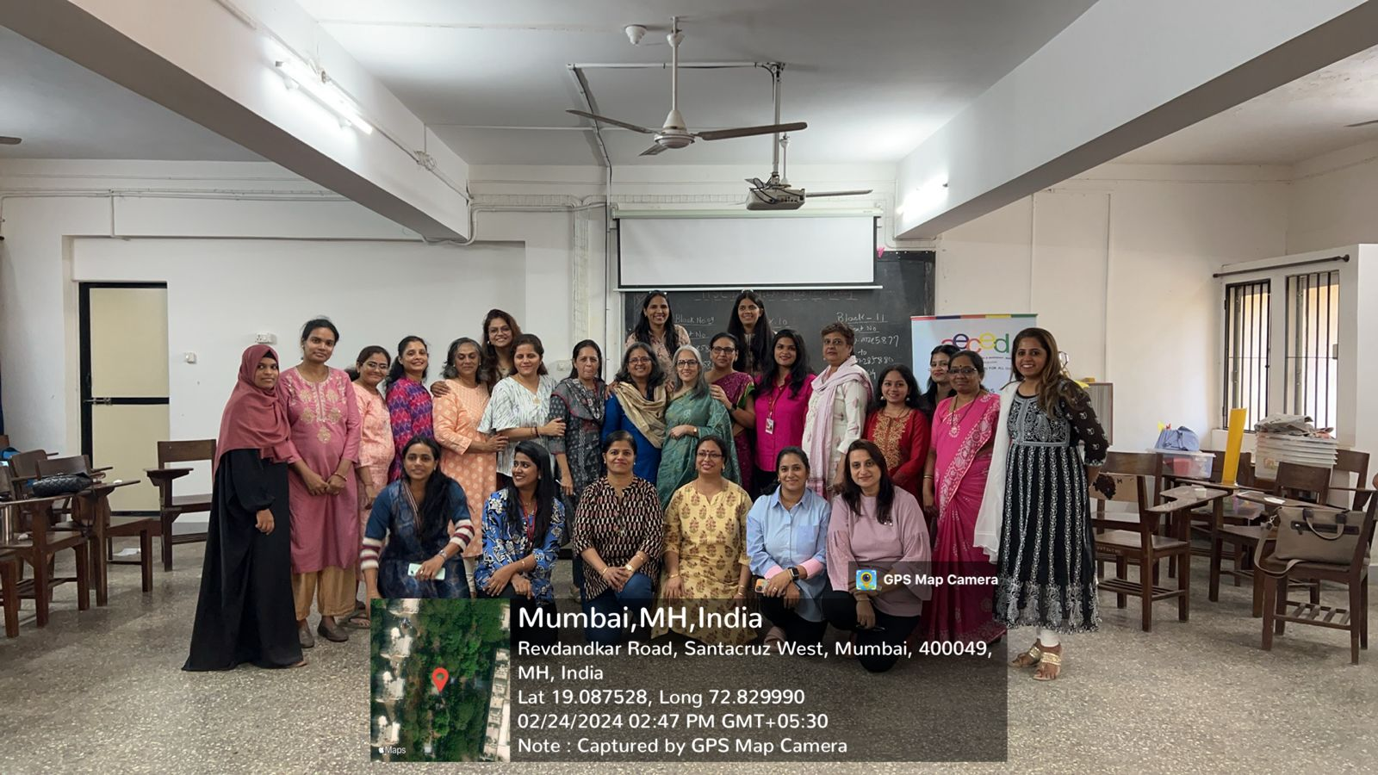
Workshop on Developing 21st Century Skills in Preschool Children on 24th February 2024 for Preschool Teachers in Collaboration with AECED

Slide 5
Workshop on Developing 21st Century Skills in Preschool Children on 24th February 2024 for Preschool Teachers in Collaboration with AECED

Slide 6
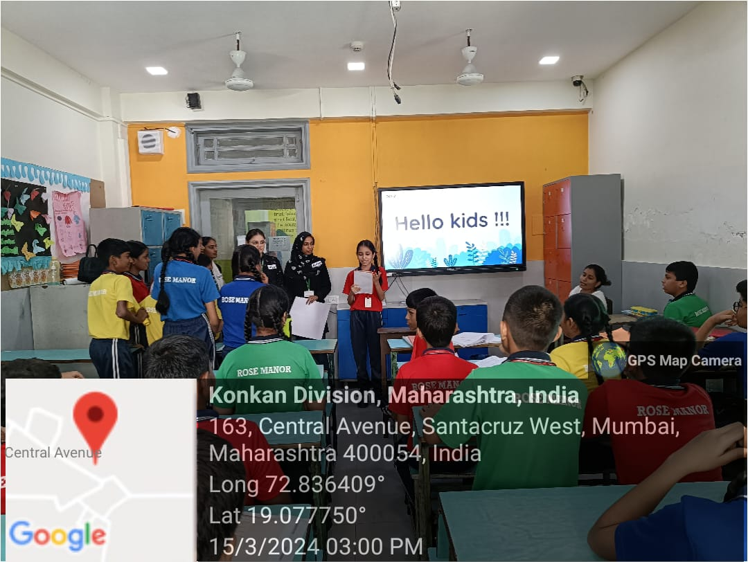
A Workshop on Sensitizing Elite Kids About Street Children on 14th & 15th March in a School

Slide 7
Workshop On “STEAMASTIC INSIGHT” in Collaboration with Learning Curve on 9th February, 2024

Slide 8
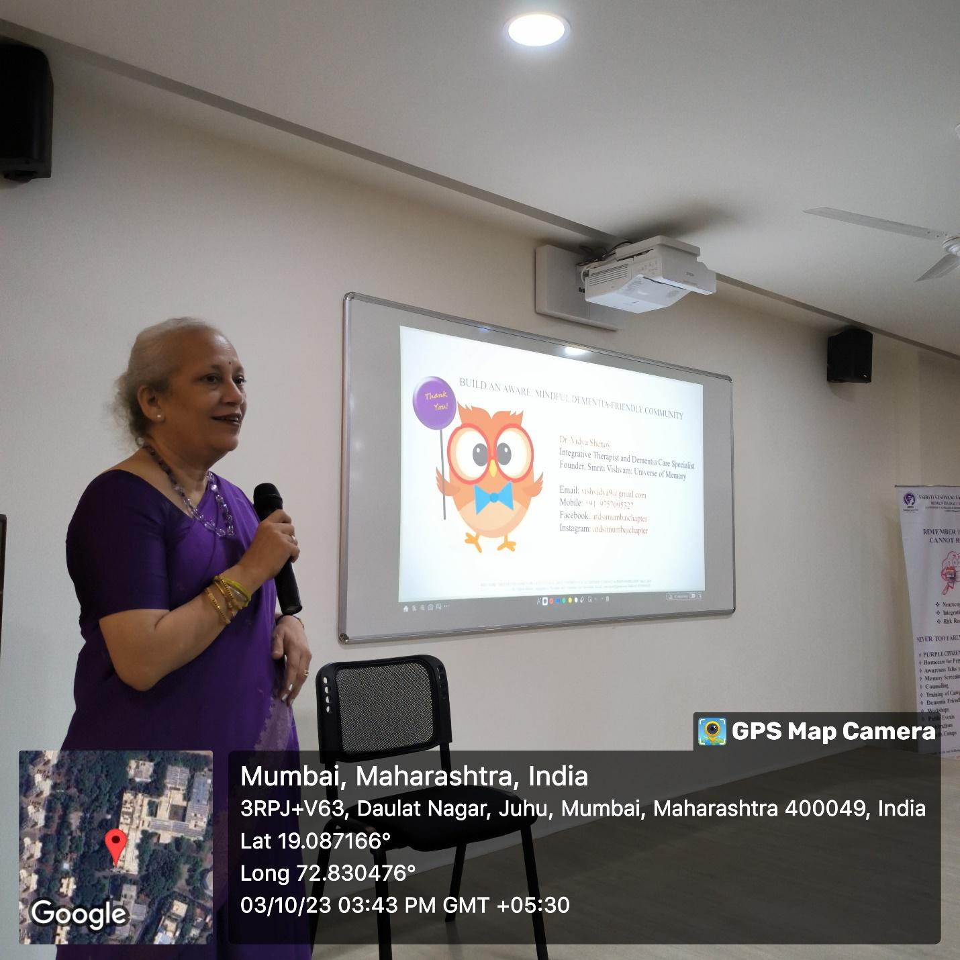
World Alzheimer's Day Celebration-Fading Memories by Dr. Vidya Shenoy on October 3, 2023

Slide 9
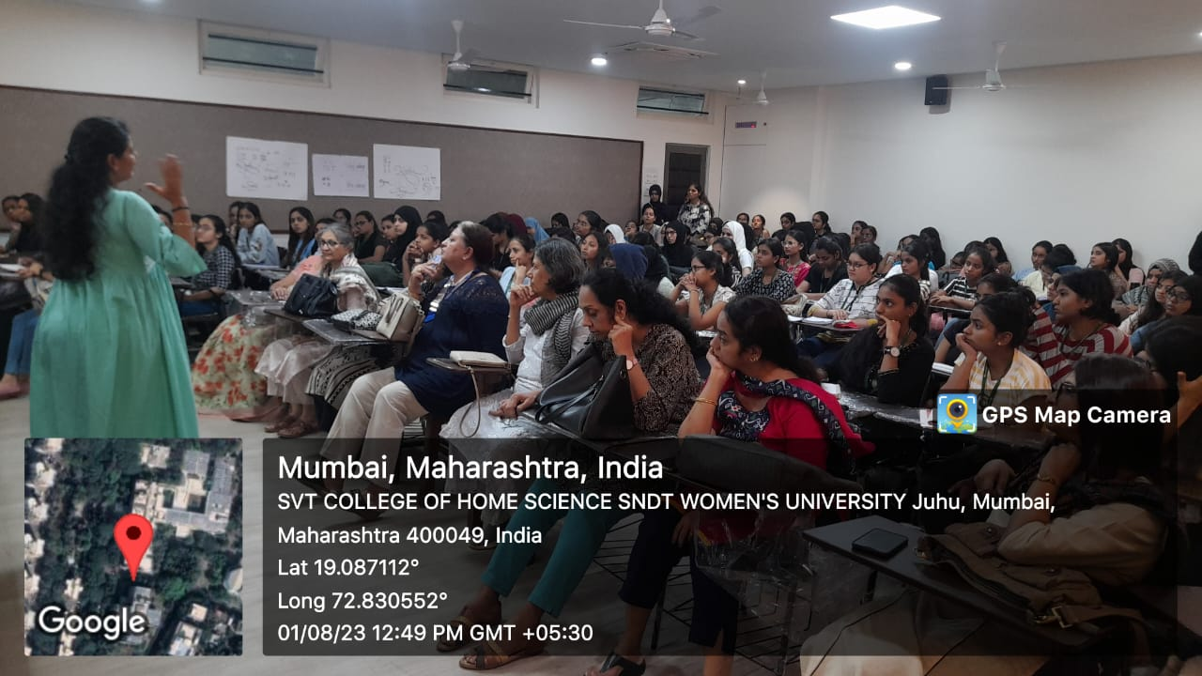
Session On ‘Importance of Breastfeeding’ in Collaboration with Inner Wheel Club of Bombay Midwest, Mumbai, on August 1, 2023 by Ms. Mansi Shah, Lactation Consultant

Slide 10
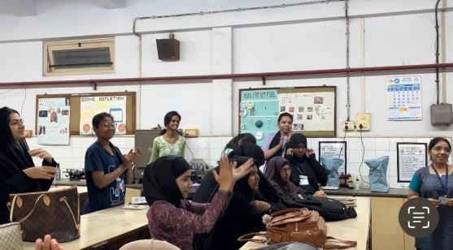
Celebration of Marathi Diwas on 27th Feb 2024

Slide 11
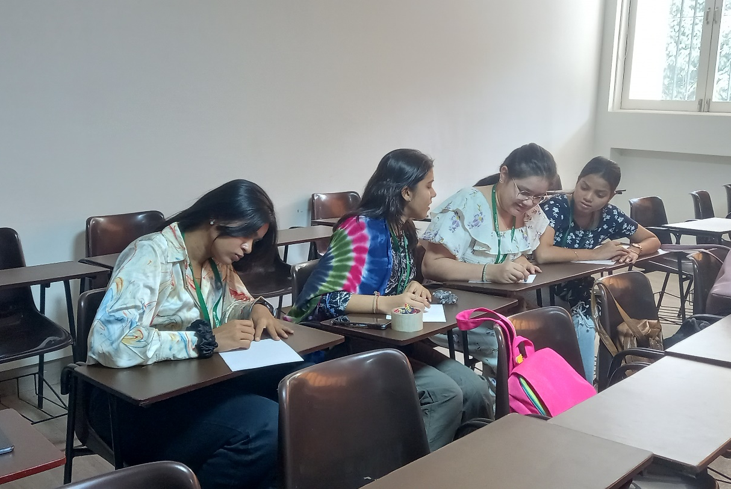
Celebration of National Youth Day 13th January 2024

Slide 12
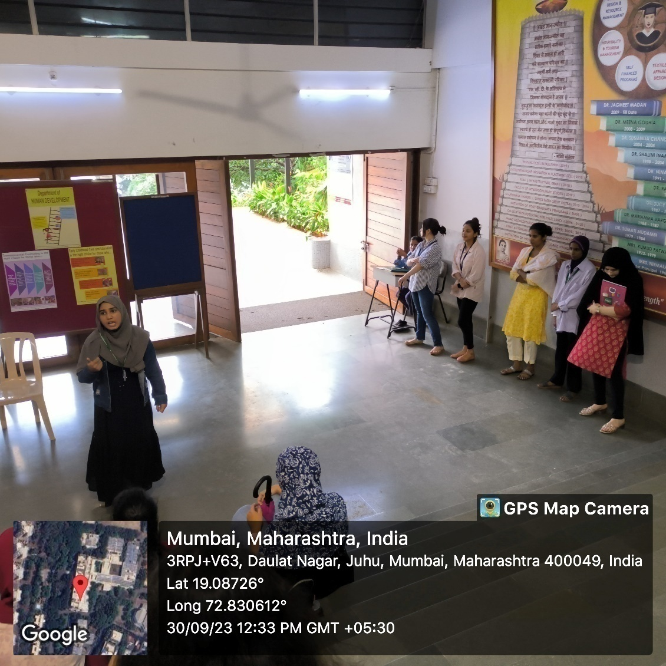
Skit on Mental Health on September 30, 2023

Slide 13
MOU Signed with Anubhuti Psychological Services, February 13, 2023

Slide 14
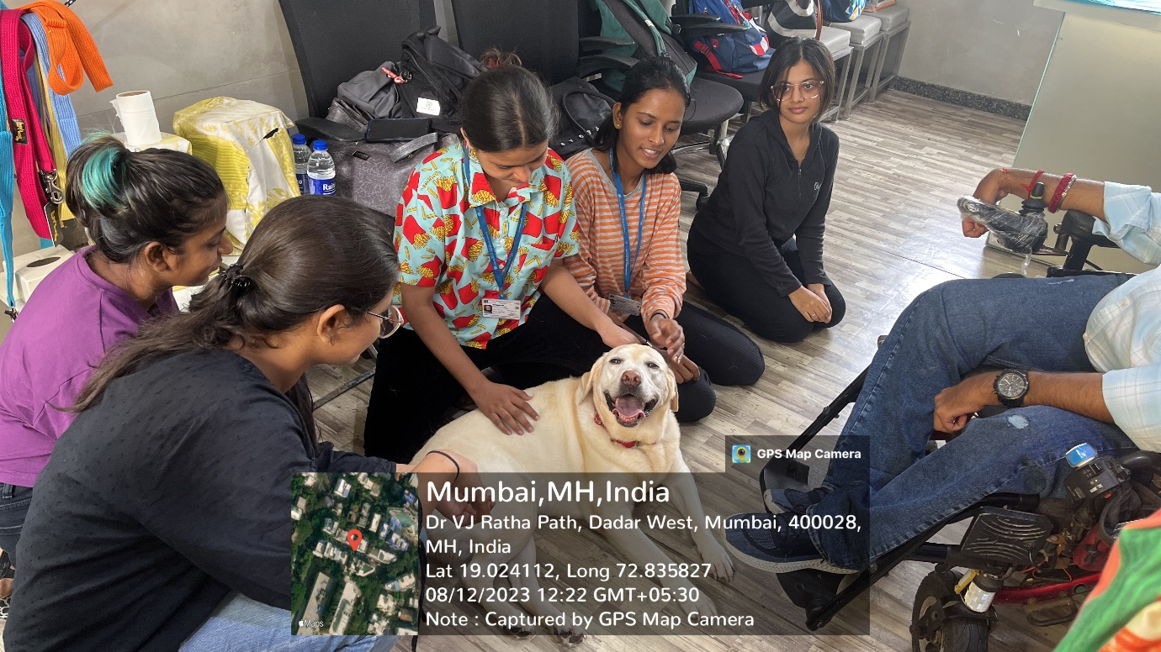
Visit to Pawsitivve Future for Therapeutic Recreation on August 12, 2023

Slide 15
Visit to Yuva Parivartan Valedictory Event 15th February 2024

Slide 16
Guest Lecture on Crimes Against Women by Ms. Vatsala Shoukla, RCWS on September 6, 2023

Slide 17
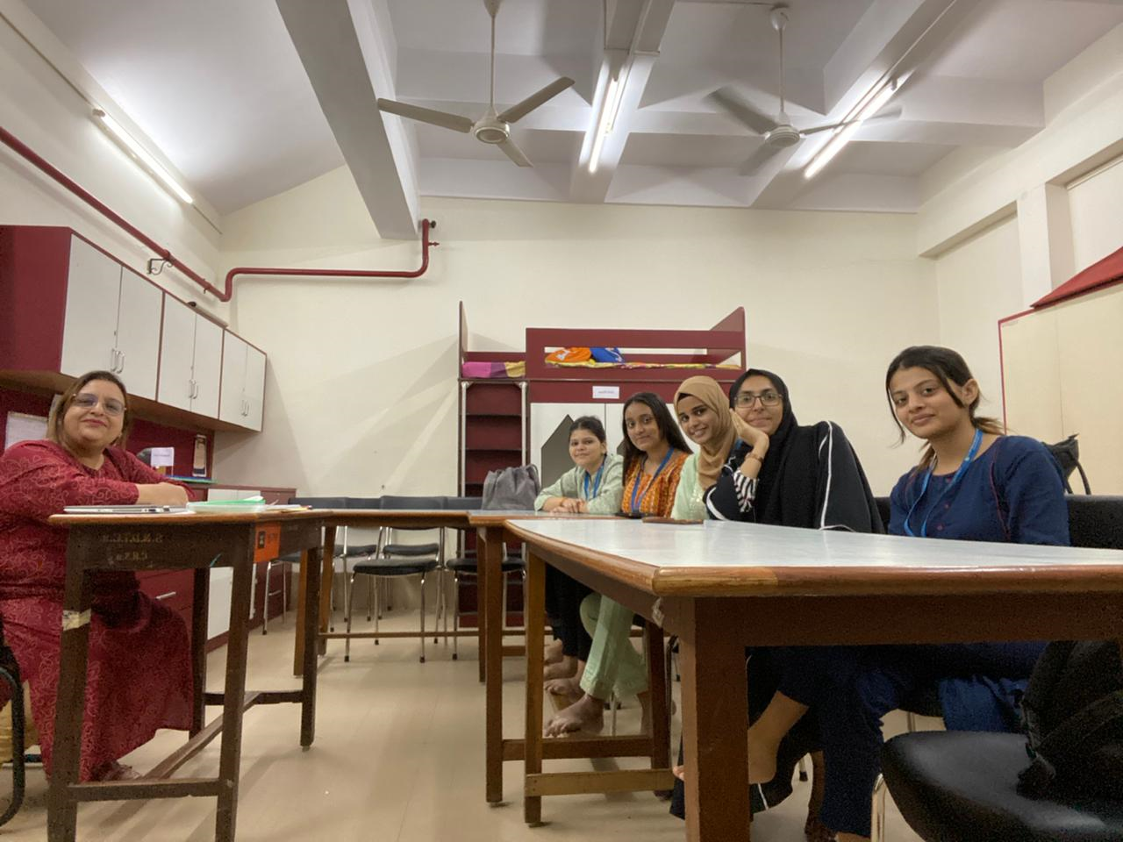
Mentor Meetings: August 10, 2023, October 16, 2023 (TY ECCE), October 10, 2023 (SY ECCE)

Slide 18
Publication
Portfolios: An intervention to enable effective assessments by early childhood educators; CIKITUSI Journal for Multidisciplinary Research Vol. 10. issue 4., pg. no. 1-4, ISSN no:0975-6876 by Bhamini Mehta, Archana Jain and Anushri Soni
Effect of childhood play on development through adolescence and emerging adulthood years; Strad Research, Vol. 11, Issue 1, pg. 108-112, ISSN:0039-2049, January-2024, by Bhamini Mehta and Anushri Soni

Slide 19
Ms. Archana Jain Invited as Resource Person by JITO (Jain International Trade Organization) to Deliver a Talk on “Life Skills For Women” on March 10, 2023

Slide 20
Ms. Archana Jain Invited as Resource Person for COALITION FOR FOOD SYSTEM TRANSFORMA(C)TION IN INDIA (Cofti) on 5th & 6th October 2023 in New Delhi

Slide 21
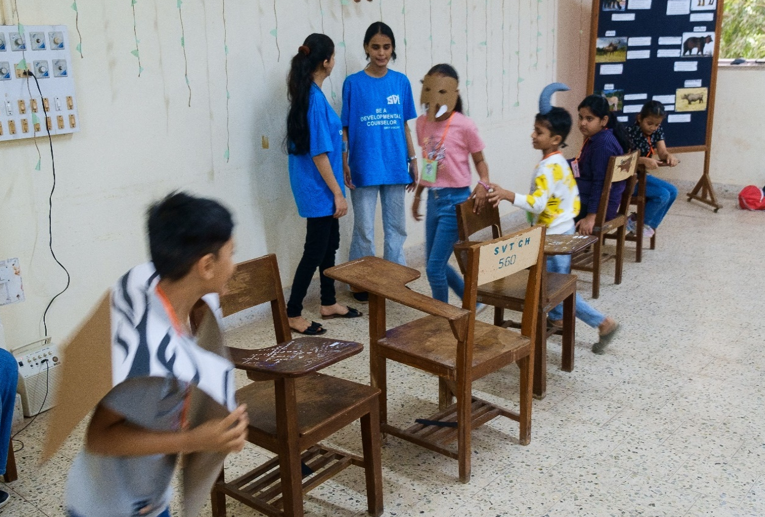
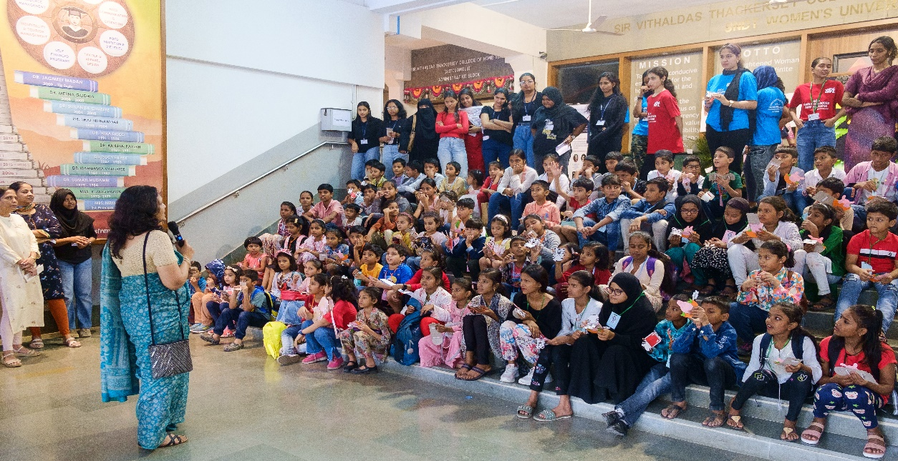
Khelutsav on Wildlife Wonders on 17th December 2023

Slide 22
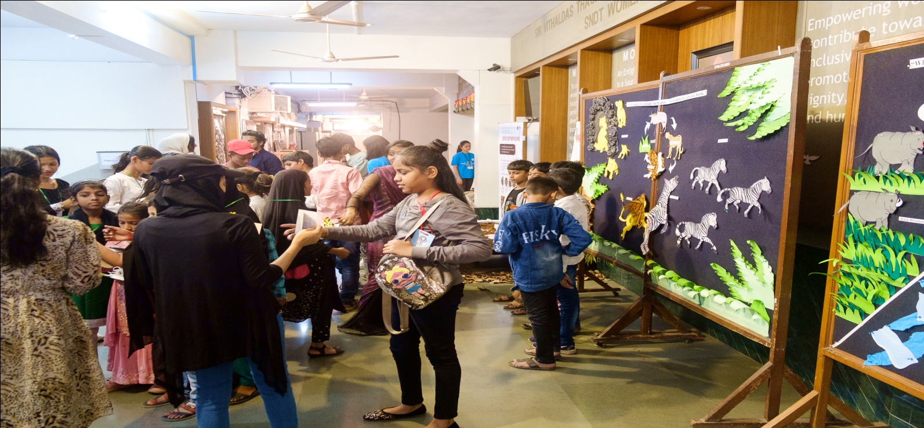
Khel Utsav on Wildlife Wonders on 17th December 2023

Slide 23
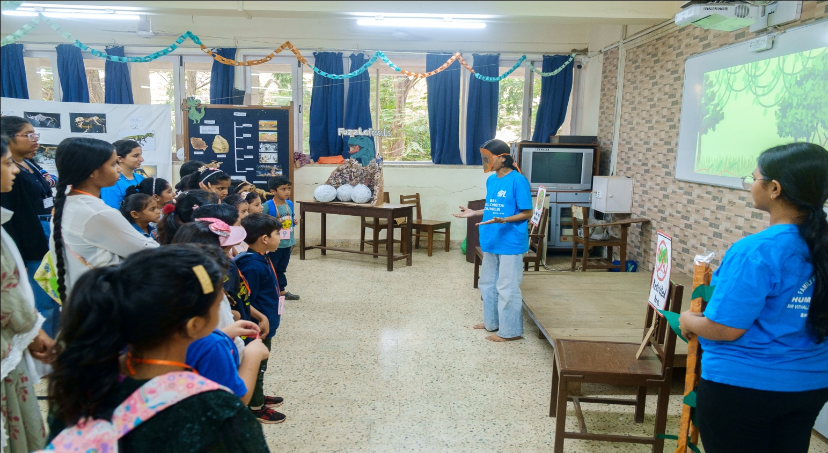
Khel Utsav on Wildlife Wonders on 17th December 2023

Slide 24
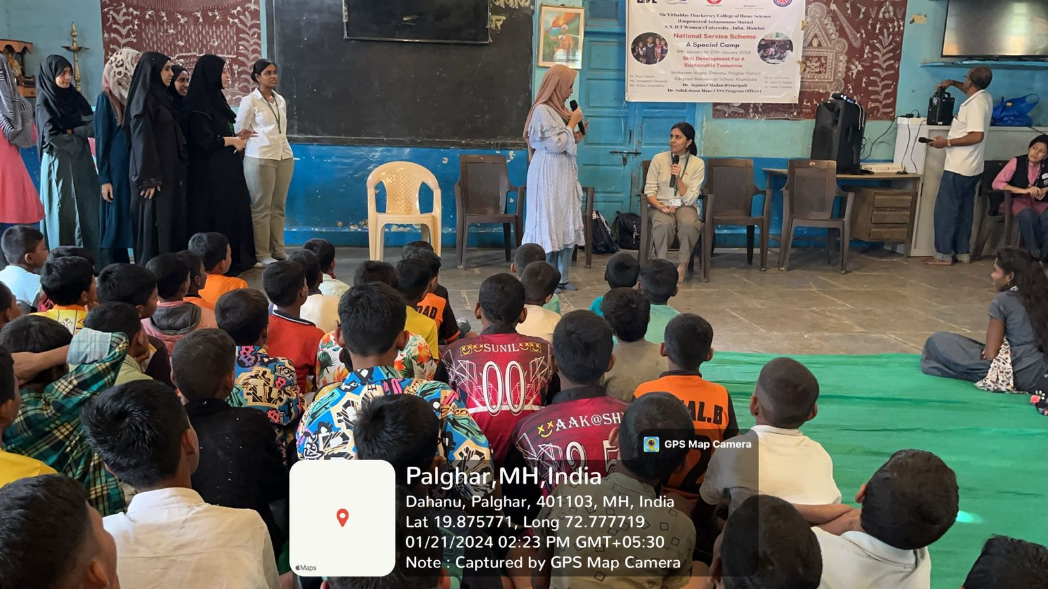
NSS Camp for Promoting Communication & Self-esteem on 21st January 2024
Demonstration on communication skills
Role play by Children

