Slide 1
ACTIVITIES and achievements OF
M. DESIGN (FASHION Design) in 2019

Slide 2
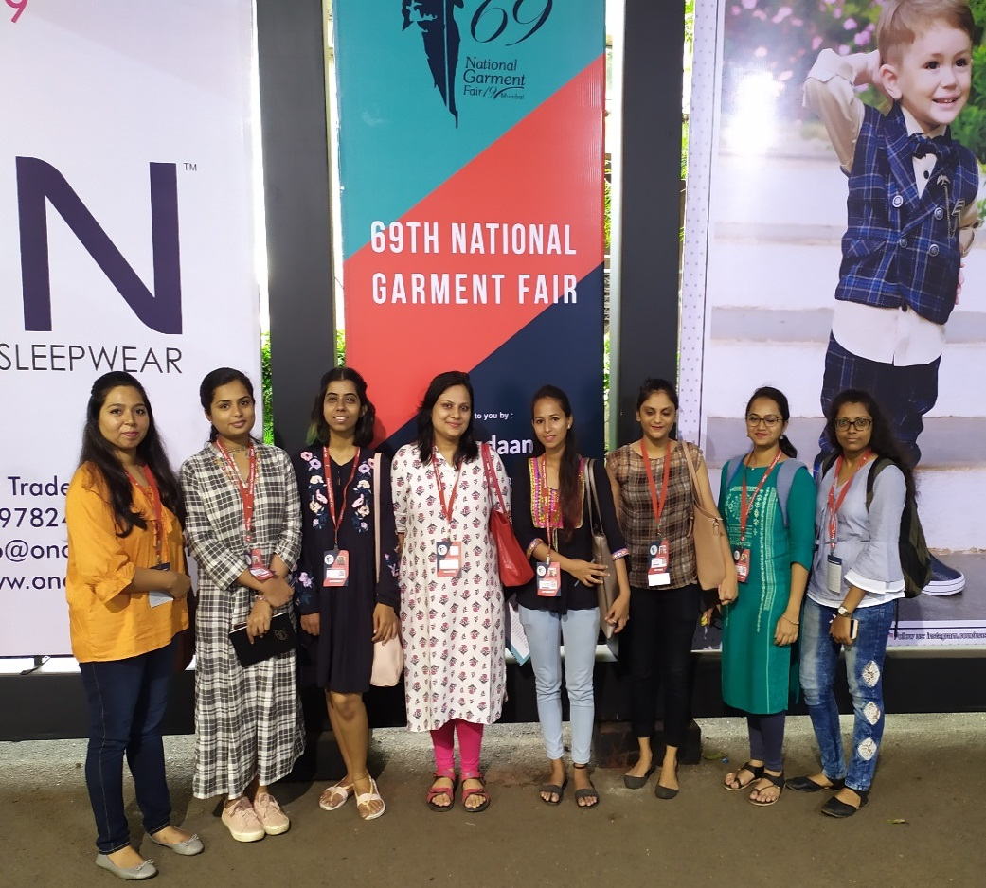
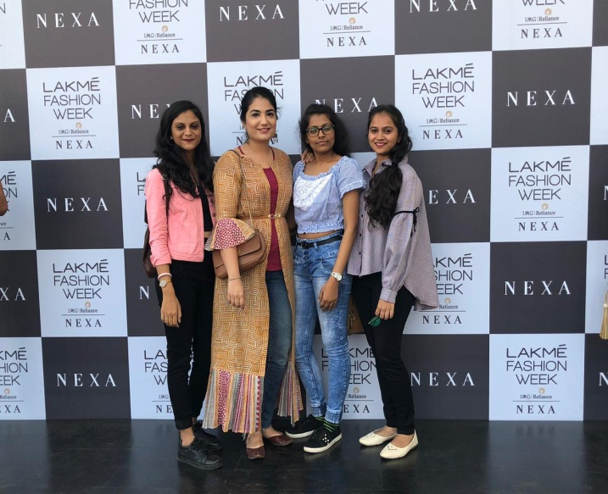
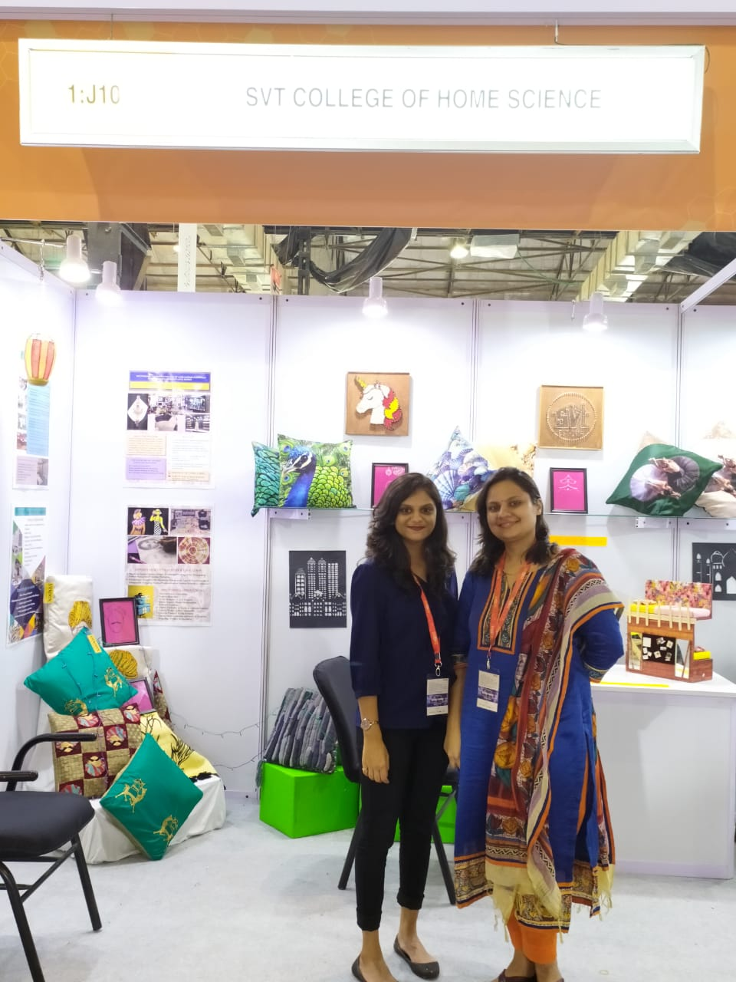
STUDENTs ACTIVITIES
Visited 69th National Garment fair at Bombay Exhibition Centre on 18th July 2019
Participated in Lakme Fashion Week, Mumbai in January 2019
Participated in Houseware, Gifts and Home Furnishing Exhibitiom organized on 3^{rd to} 5th July 2019, in Bombay Exhibition Centre, Mumbai

Slide 3
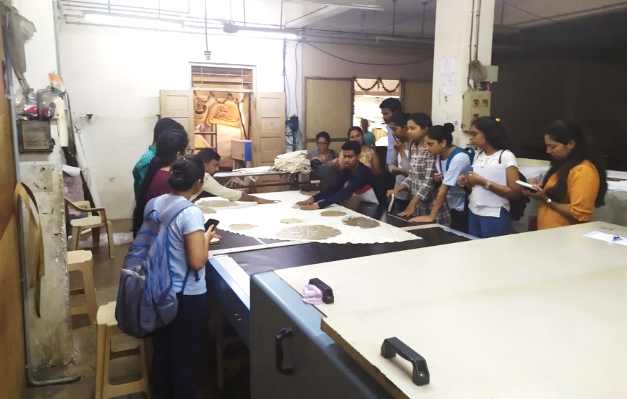
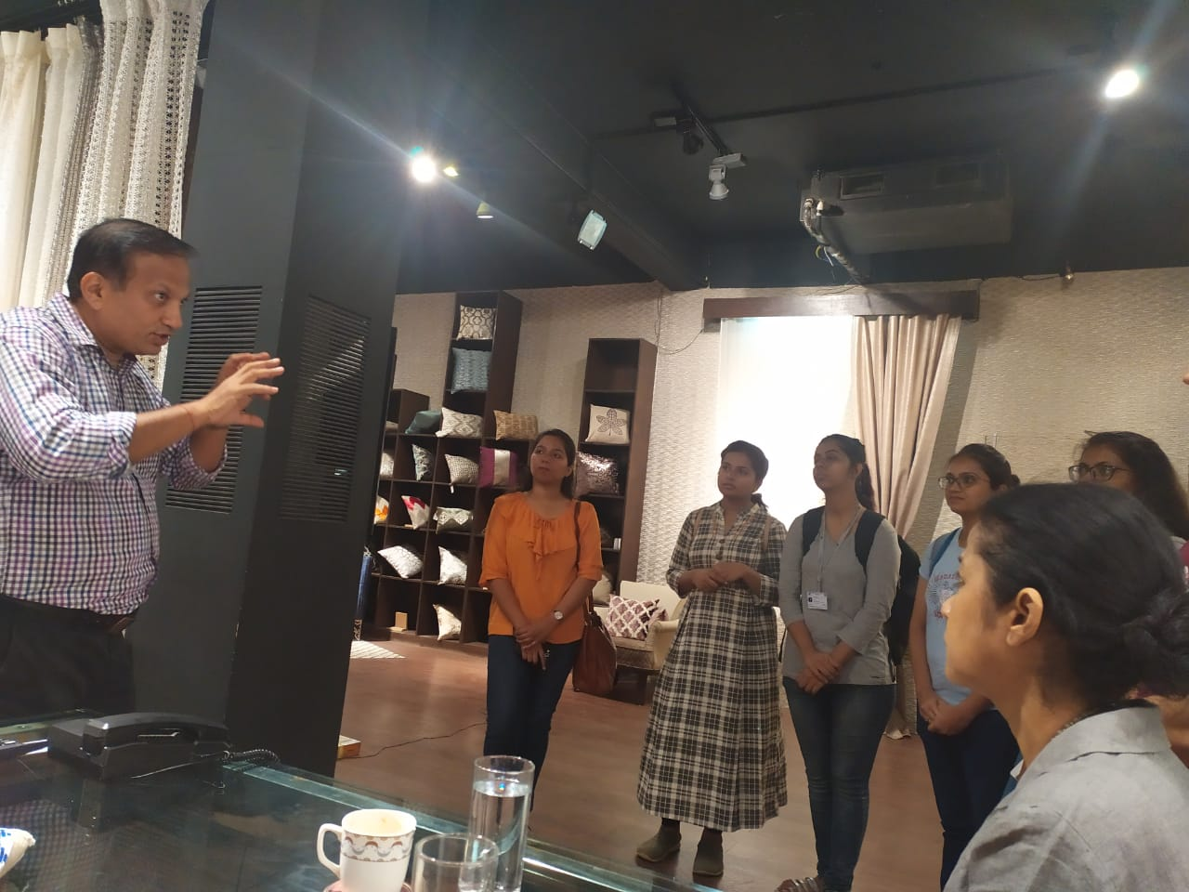
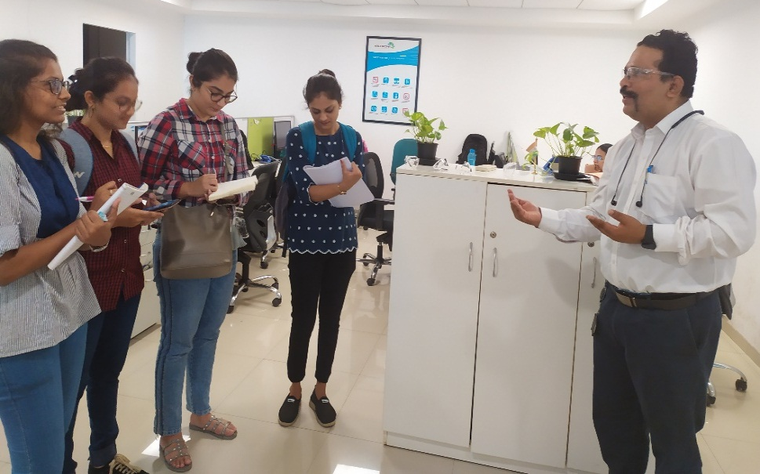
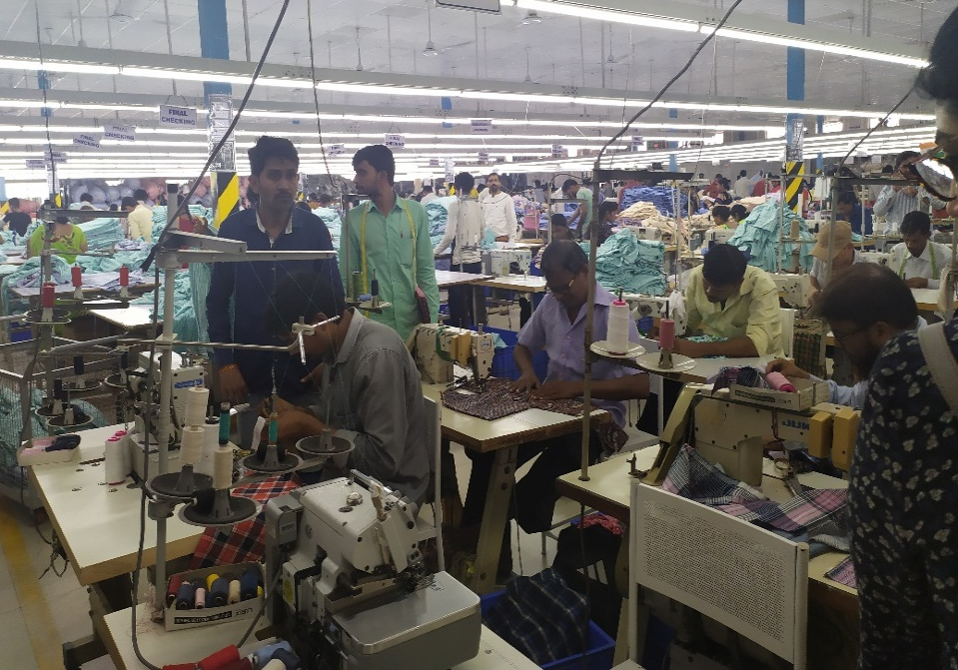
STUDENTs ACTIVITIES
Visited Punikim Industries Pvt. Ltd. On 22 November 2019 to see the Innovative Fabric development
Visited Creative Garments Pvt. Ltd. On 5th Dec 2019 to understand the Production Management in Garment Factory
Visited Archroma India Pvt. Ltd. On 26th November 2019 to gain insights of dyeing and finishing for Textile Industry

Slide 4
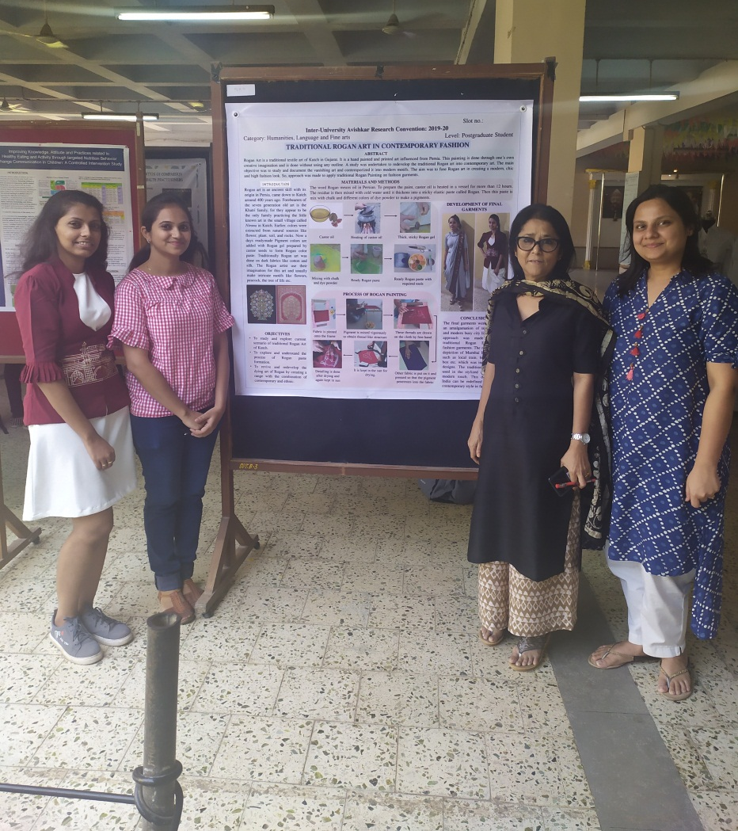
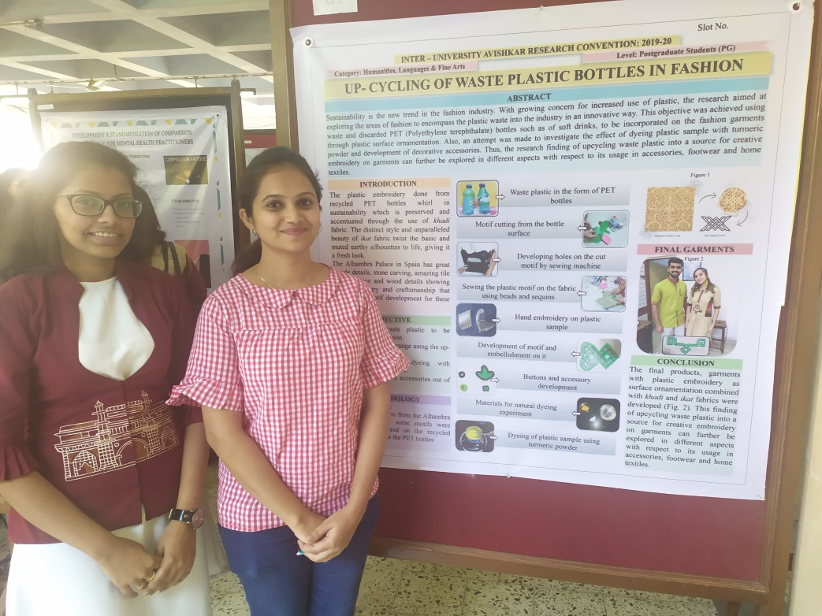
STUDENTs ACTIVITIES
Participated in AVISHKAR 2020, Inter University Research Convention held on 15th January and got selected for Final poster presentation.

Slide 5
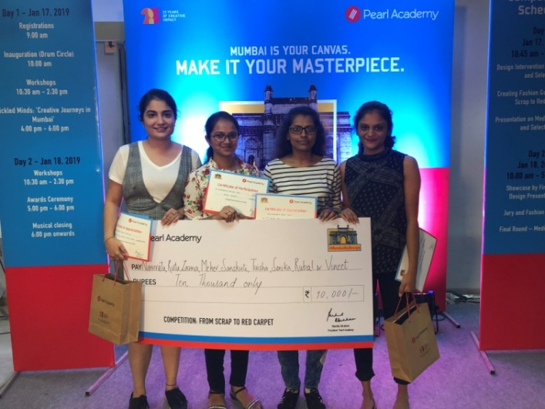
Students ACHIEVEMENTs 2019
Students of M.Design (Fashion Design) were awarded 1st Prize in Fashion Forward – Scrap to Red Carpet competition at Mumbai By Design, organised by Pearl Academy, Mumbai on 18th January 2019. Students recieved INR 10, 000 cash prize .

Slide 6
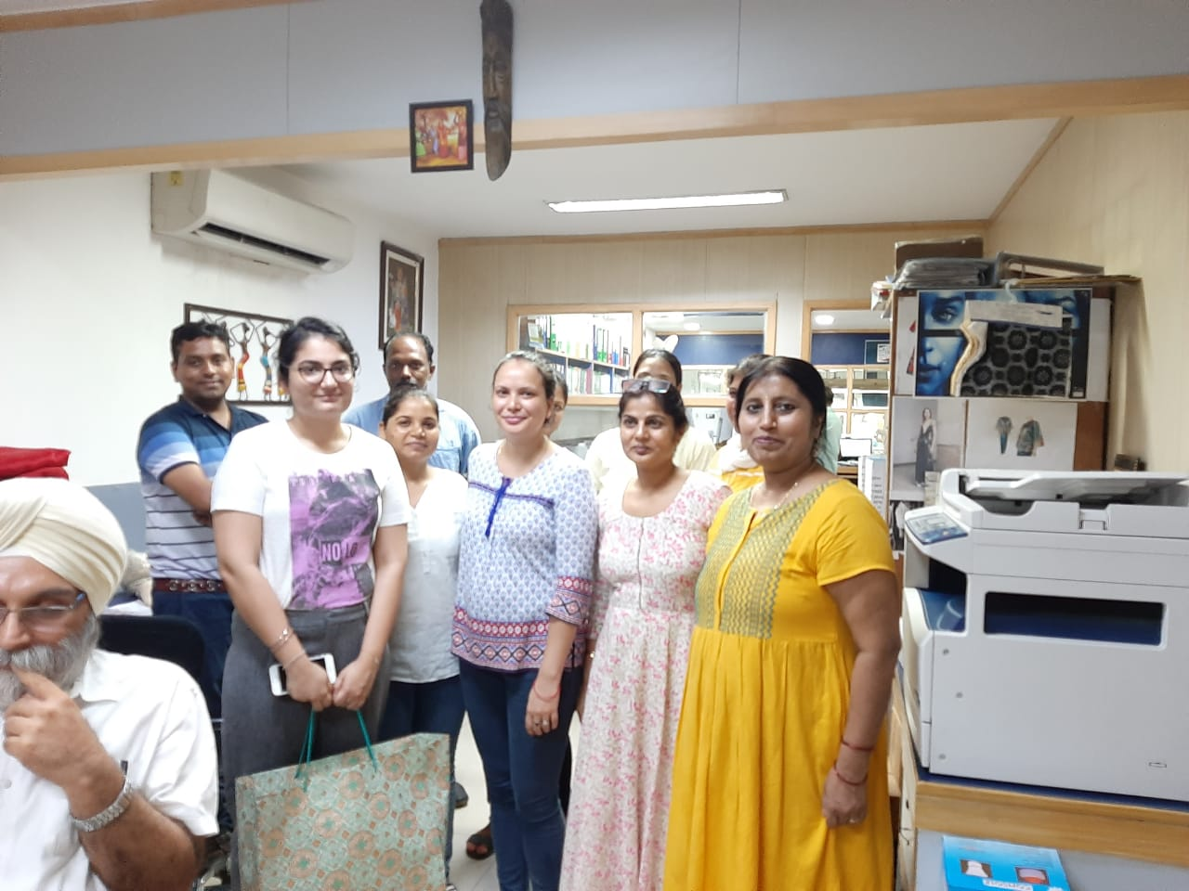
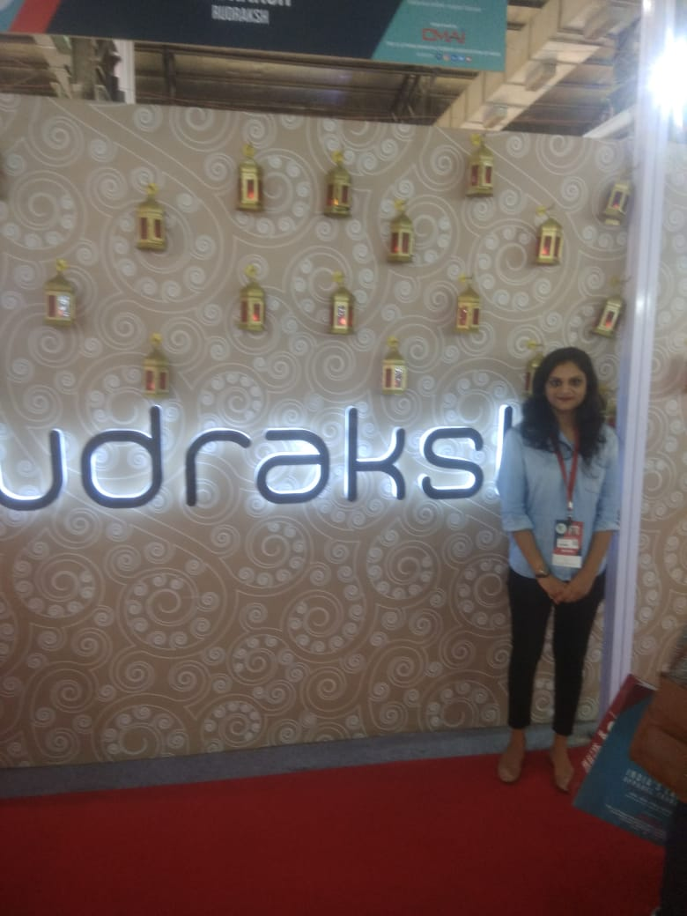
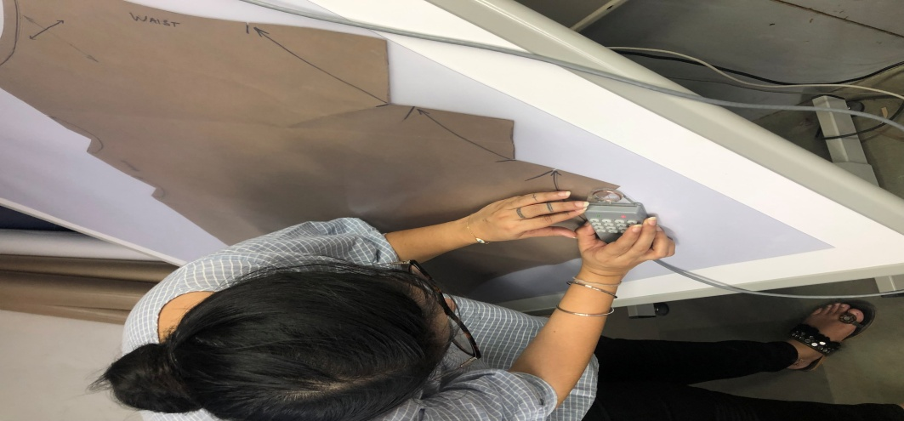
INTERNSHIP
Rudraksh, Mumbai
Mahima Exports, Noida

Slide 7
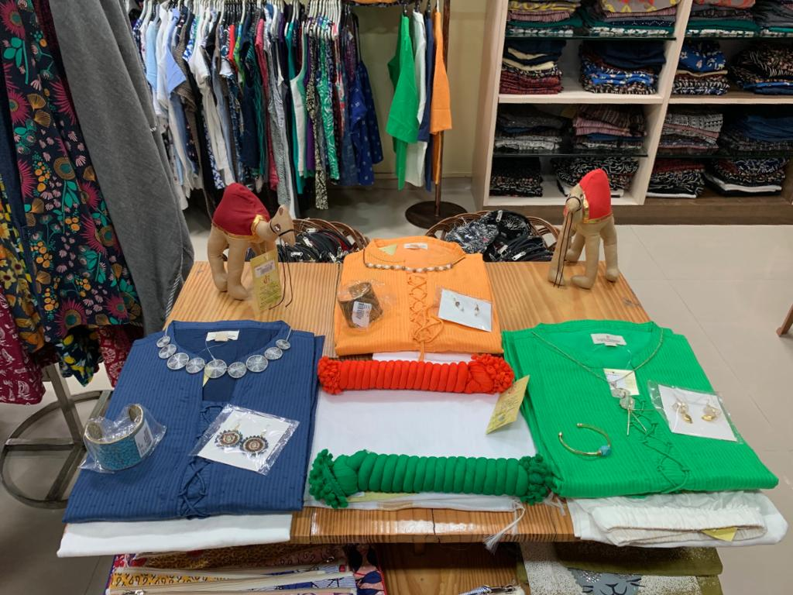
INTERNSHIP
CREATIVE HANDICRAFTS, Mumbai
One student worked as Bollywod Fashion Stylist

Slide 8
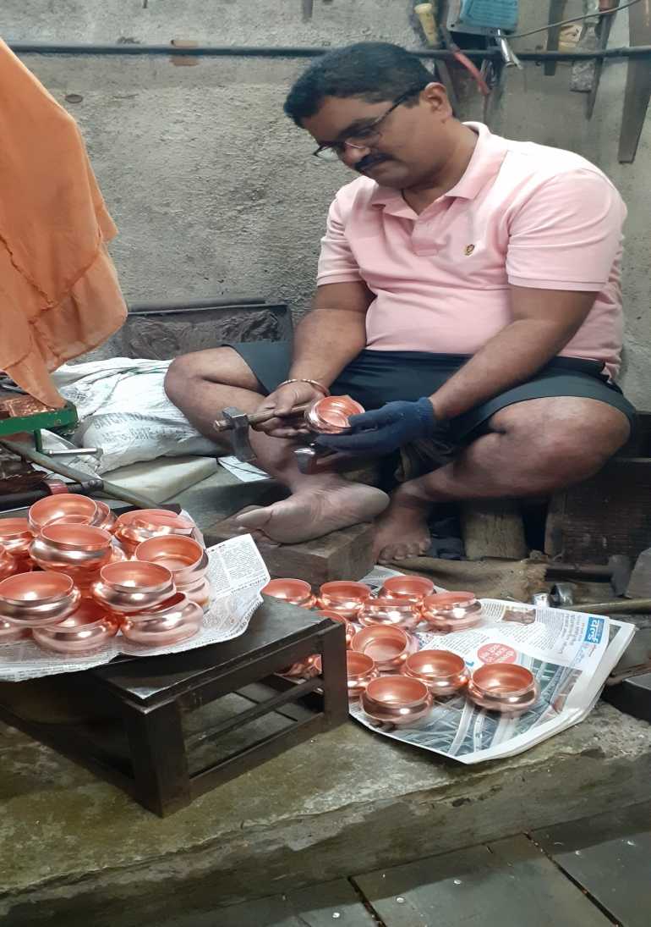
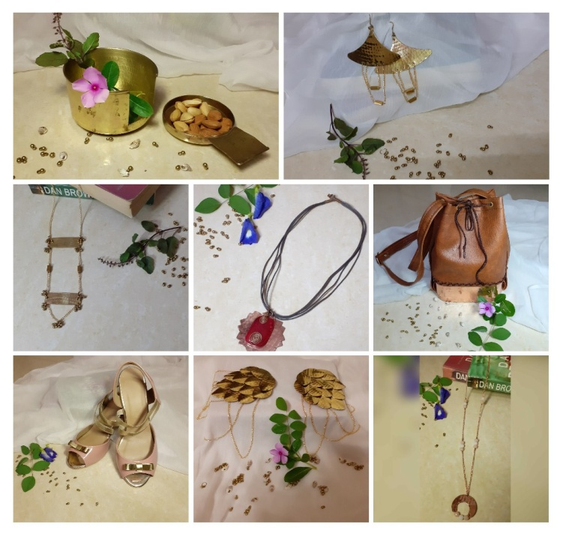
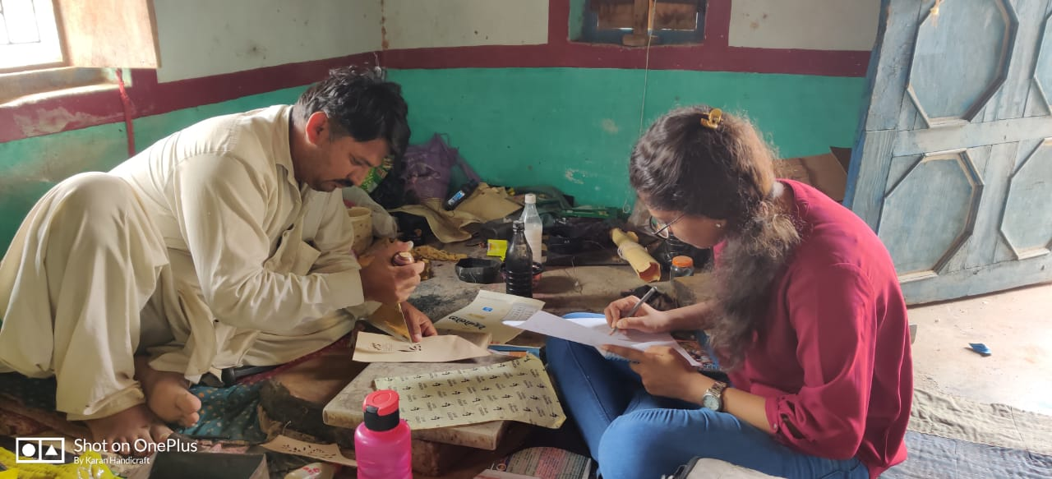
CRAFT DOCUMENTATION- Students Visiting Artisans and learning the craft
Tambat Kaam
Leather Craft

Slide 9
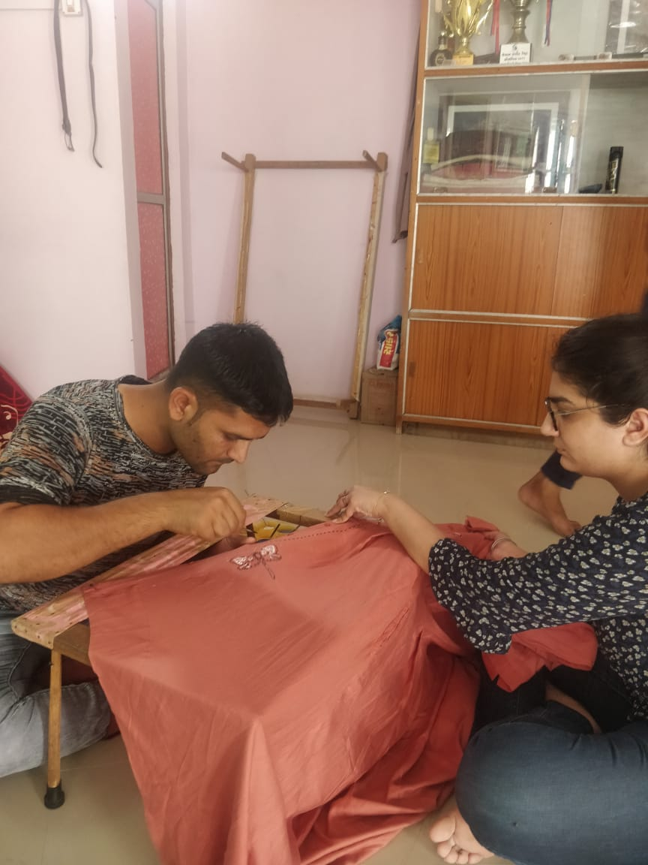
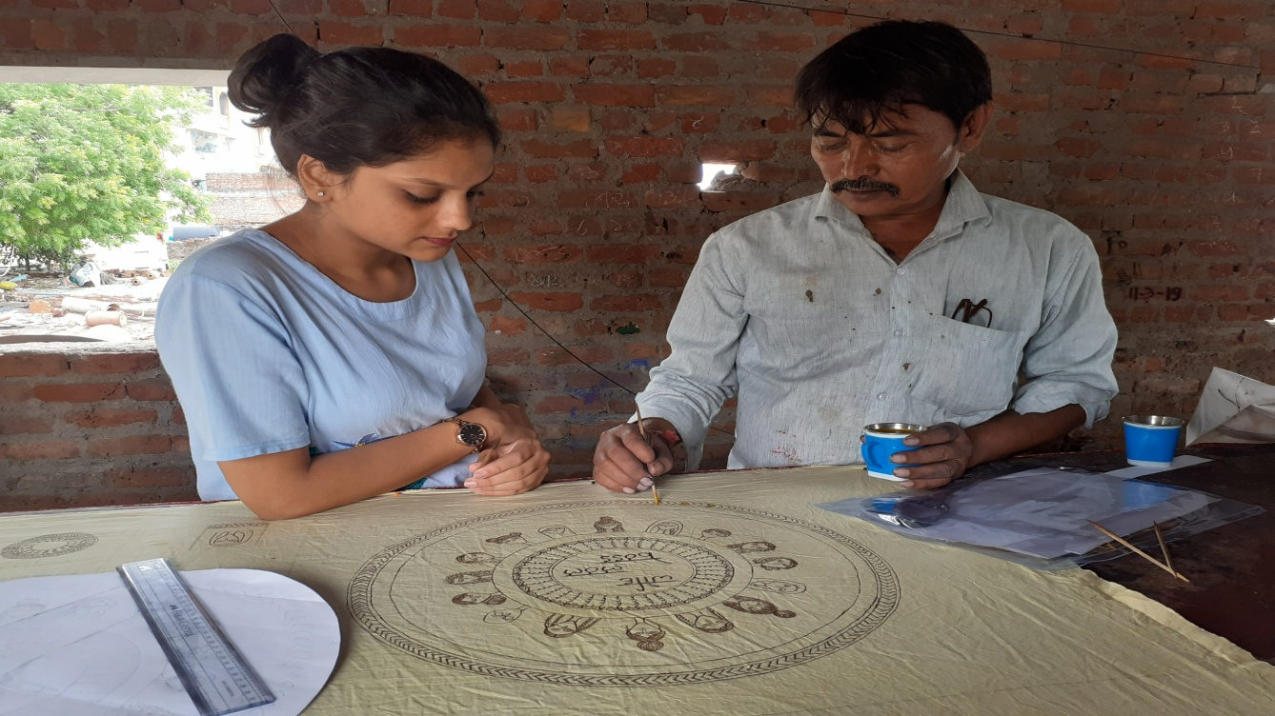
CRAFT DOCUMENTATION - Students Visiting Artisans and learning the craft
Rogan painting
Mata ni Pachedi

